Slide 1
Zanidatamab + Chemotherapy for Patients With HER2-Expressing Metastatic Breast Cancer
Final Results of a Phase 1 Trial
Philippe L. Bedard,¹ Seock-Ah Im,² Elena Elimova,¹ Sun Young Rha,³ Rachel Goodwin,⁴ Cristiano Ferrario,⁵ Keun-Wook Lee,⁶ Anastasia Martynova,⁷ Funda Meric-Bernstam,⁸ Peter Kabos,⁹ Murali Beeram,¹⁰ Erika Hamilton,^{11,}* Melody Cobleigh,¹² Theresa Samuel Nached,¹³ Keerti Sharma,¹³ Do-Youn Oh²
*Presenting Author
¹Princess Margaret Cancer Centre, University Health Network, University of Toronto, Toronto, ON, Canada; ²Seoul National University Hospital, Cancer Research Institute, Seoul National University College of Medicine, Seoul, Korea; ³Yonsei Cancer Center, Yonsei University College of Medicine, Seoul, Korea; ⁴University of Ottawa Cancer Centre, Ottawa, ON, Canada; ⁵Jewish General Hospital, Montréal, QC, Canada; ⁶Seoul National University College of Medicine, Seoul National University Bundang Hospital, Seongnam, Korea; ⁷USC Norris Comprehensive Cancer Center, Los Angeles, CA, USA; ⁸University of Texas MD Anderson Cancer Center, Houston, TX, USA; ⁹University of Colorado Cancer Center, Aurora, CO, USA; ¹⁰The START Center for Cancer Care, San Antonio, TX, USA; ¹¹Sarah Cannon Research Institute, Nashville, TN, USA; ¹²Rush University, Chicago, IL, USA; ¹³Jazz Pharmaceuticals, Philadelphia, PA, USA

Slide 2
DECLARATION OF INTERESTS
Erika Hamilton has received grants (to her institution only for consulting advisory roles) from Accutar Biotechnology, Arvinas, AstraZeneca, BeOne Medicines, Circle Pharma, Daiichi-Sankyo, Entos, Gilead Sciences, Halda Therapeutics, Incyclix Bio, IQVIA, Janssen, Jazz Pharmaceuticals, Jefferies LLC, Johnson and Johnson, Lilly, Medical Pharma Services, Mersana, Novartis, Pfizer, Pyxis Oncology, Roche/Genentech, Samsung Bioepis, Shorla Pharma, Stemline Therapeutics, Tempus Labs and Zentalis Pharmaceuticals; and has received research contracts or funding (to her institution only) from AbbVie, Accutar Biotechnology, Acerta Pharma, ADC Therapeutics, AKESOBIO Australia, Amgen, Aravive, ArQule, Artios, Arvinas, AstraZeneca, AtlasMedx, BeOne Medicine, Black Diamond, Bliss BioPharmaceuticals, Boehringer Ingelheim, Bristol Myers Squibb, Cascadian Therapeutics, Clovis, Compugen, Context Therapeutics, Cullinan, Curis, CytomX, Daiichi-Sankyo, Dana Farber Cancer Institute, Dantari, Deciphera, Duality Biologics, eFFECTOR Therapeutics, Eisai, Ellipses Pharma, Elucida Oncology, EMD Serono, Fochon Pharmaceuticals, FujiFilm, G1 Therapeutics, Gilead Sciences, H3 Biomedicine, Harpoon, Hutchinson MediPharma, Immunogen, Immunomedics, Incyte, Infinity Pharmaceuticals, Inspirna, InventisBio, Jacobio, Karyopharm, K-Group Beta, Kind Pharmaceuticals, Leap Therapeutics, Lilly, Loxo Oncology, Lycera, Mabspace Biosciences, Macrogenics, MedImmune, Mersana, Merus, Millennium, Molecular Templates, Myriad Genetic Laboratories, Novartis, Nucana, Olema, OncoMed, Oncothyreon, ORIC Pharmaceuticals, Orinove, Orum Therapeutics, Pfizer, PharmaMar, Pieris Pharmaceuticals, Pionyr Immunotherapeutics, Plexxikon, Prelude Therapeutics, Profound Bio, Radius Health, Regeneron, Relay Therapeutics, Repertoire Immune Medicine, Rgenix, Roche/Genentech, Seagen, Sermonix Pharmaceuticals, Shattuck Labs, Silverback Therapeutics, StemCentRx, Stemline Therapeutics, Sutro, Syndax, Syros, Taiho, TapImmune, Tesaro, Tolmar, Torque Therapeutics, Treadwell Therapeutics, Verastem, Zenith Epigenetics and Zymeworks.
Presenter:
Erika Hamilton, MD Chair, Breast Executive Committee
Director, Breast Cancer Research Program
Sarah Cannon Research Institute

Slide 3
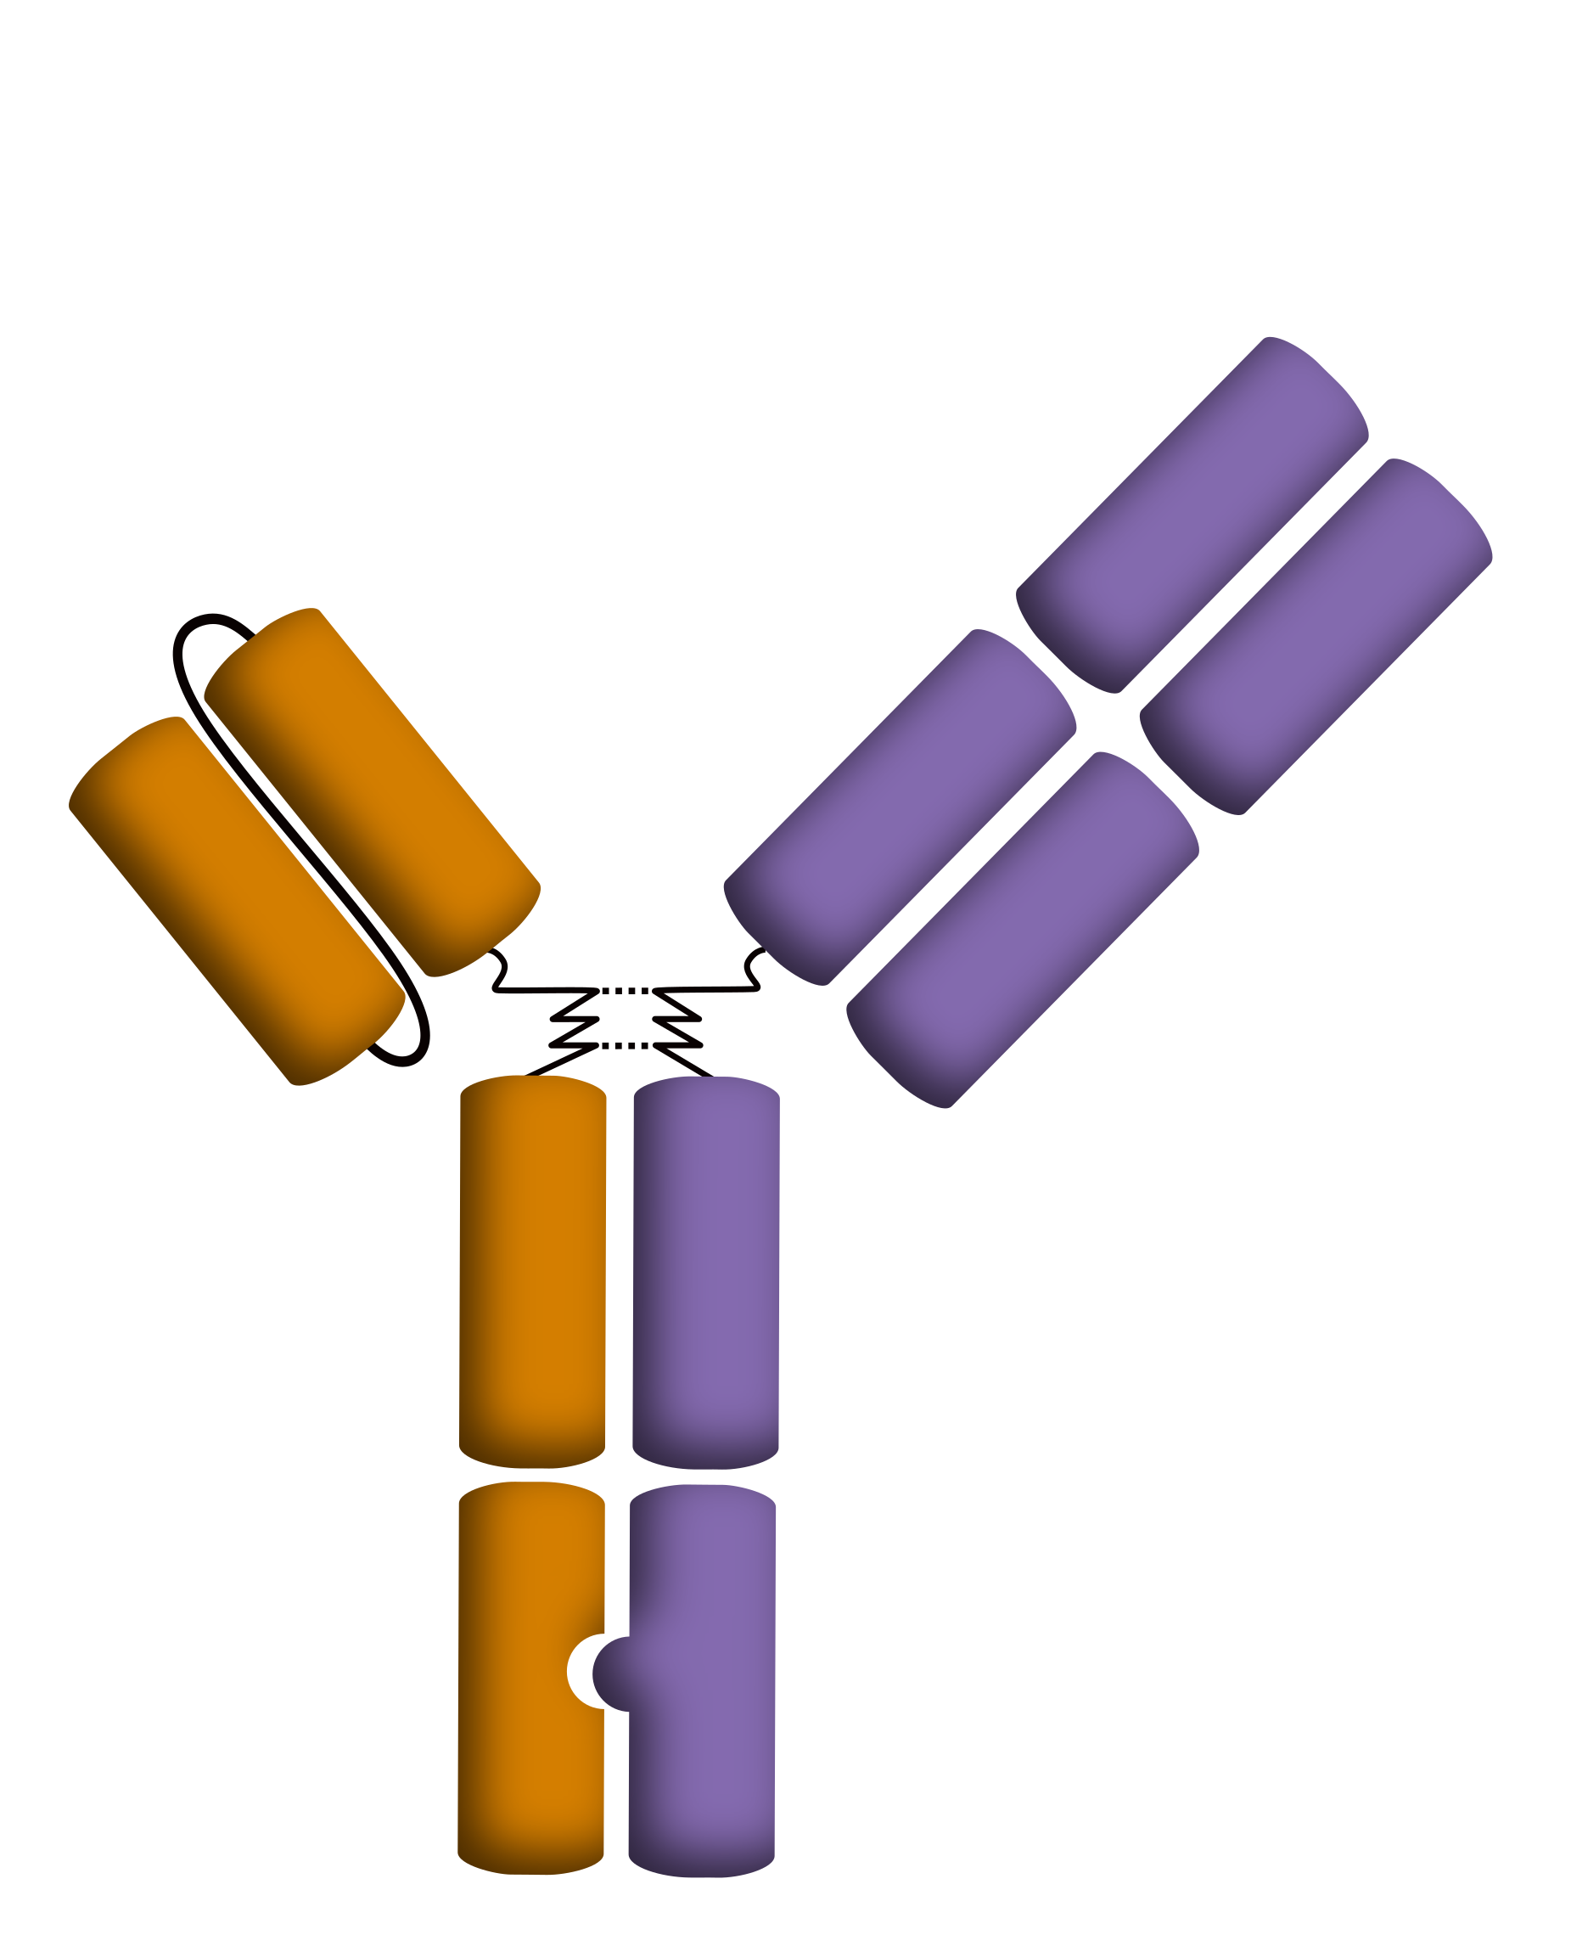
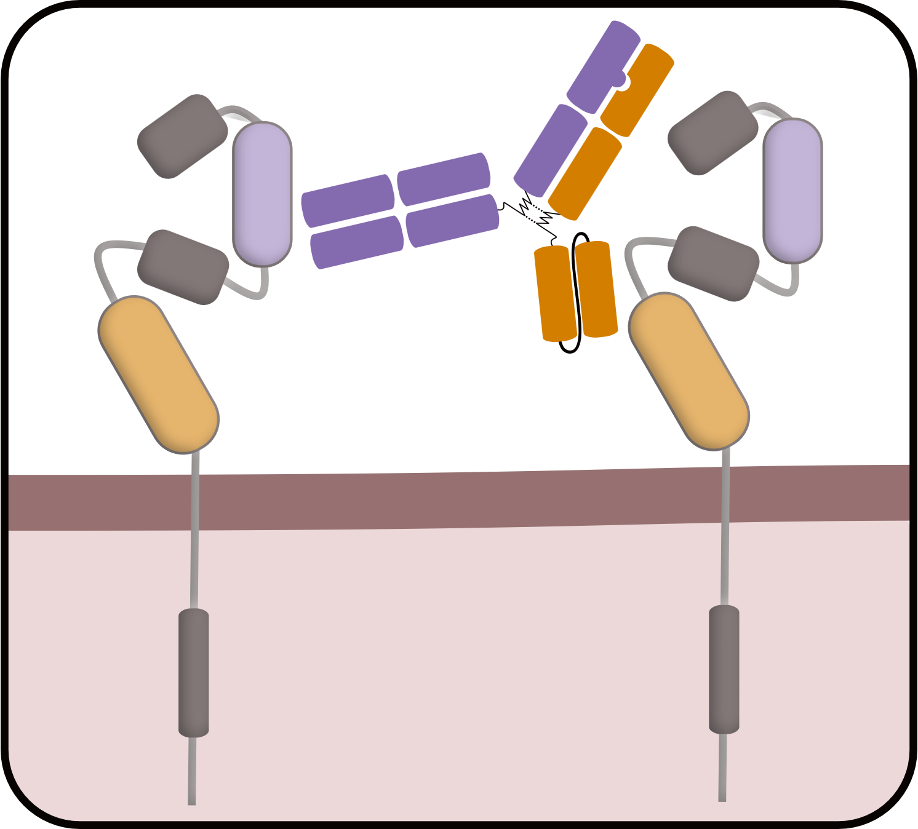
Background
Zanidatamab
Dual HER2-targeted bispecific antibody¹
There is an unmet need for additional effective HER2-targeted treatment regimens for patients with HER2-positive metastatic breast cancer whose disease has progressed on prior HER2-targeted therapies
Zanidatamab is a dual HER2-targeted bispecific antibody designed to bind to 2 non-overlapping domains on HER2 in trans that in preclinical studies drove multiple antitumour mechanisms of action, including¹:
Facilitation of HER2 internalisation and subsequent degradation
Inhibition of HER2 homo- and hetero-dimerisation
Activation of immune mediated effects (complement-dependent cytotoxicity and antibody‑dependent cellular cytotoxicity and phagocytosis)
Zanidatamab has previously demonstrated promising efficacy with a manageable safety profile in patients with HER2-positive tumours, including metastatic breast cancer²
HER2 ECD2
binding region
HER2 ECD4
binding region
Here, we report the final analysis from part 3 of a phase 1 trial of zanidatamab plus chemotherapy in patients with HER2-expressing metastatic breast cancer
HER2
ECD, extracellular domain; HER2, human epidermal growth factor receptor 2. 1. Weisser NE, et al. Nat Commun. 2023;14(1):1394. 2. Bedard PL, et al. Cancer Research. 2022;82(Supplement 4): Abstract P2-13-07.
Erika Hamilton, MD

Slide 4
Study Design
Parallel single-arm cohorts (no randomisation)
Zanidatamab + vinorelbine^{b}
Part 3 of a phase 1 trial (NCT02892123)
HER2-positive mBC
(IHC 3+ or IHC 2+/FISH+)
Prior trastuzumab, pertuzumab, T-DM1
1-3 prior chemotherapy regimens
Zanidatamab + capecitabine^{c}
Primary endpoint
Frequency and severity of adverse events
Key secondary endpoints
Objective response rate
Disease control rate
Duration of response
Progression-free survival
Select eligibility criteria
Unresectable, locally advanced or metastatic HER2-expressingª breast cancer
ECOG PS ≤1
Stable brain metastases allowed
Zanidatamab + paclitaxel^{d}
Zanidatamab + capecitabine and tucatinib^{e}
Zanidatamab + vinorelbine^{b}
HER2-low mBC
(IHC 1+ or IHC 2+/FISH-)
1-3 prior chemotherapy regimens
Zanidatamab + capecitabine^{c}
Until disease progression, unacceptable toxicity or until other discontinuation criteria
Zanidatamab + paclitaxel^{d}
Patients who withdrew chemotherapy could continue zanidatamab monotherapy
ªHER2 status was based on central lab assessment if available; ^{b}Vinorelbine: 25 mg/m² on days 1, 8, 15 and 22 or on days 1 and 15 for the HER2-positive subgroup; ^{c}Capecitabine: 2000 mg twice daily for 7 days in weeks 1 and 3 across HER2 subgroups or 1000 mg/m² twice daily on days 1-14 of a 21-day cycle for the HER2-positive subgroup; ^{d}Paclitaxel: 80 mg/m² QW for weeks 1-3; ^{e}Capecitabine: 1000 mg/m² twice daily on days 1-14 of a 21-day cycle; tucatinib: 300 mg twice daily.
ECOG PS, Eastern Cooperative Oncology Group performance status; FISH, fluorescence in situ hybridisation; HER2, human epidermal growth factor receptor 2; IHC, immunohistochemistry; mBC, metastatic breast cancer; QW, once weekly; T-DM1, trastuzumab emtansine.
Erika Hamilton, MD

Slide 5
Demographics and baseline characteristics
46 patients were treated (zanidatamab + vinorelbine, n=20; zanidatamab + capecitabine, n=19; zanidatamab + paclitaxel, n=5; zanidatamab + capecitabine and tucatinib, n=2)
 | All Patients (N=46)
Median age, years (range) | 54 (35-72)
Female, n (%) | 45 (98)
Race,ª n (%) Asian White Black or African American Unknown | 25 (54) 19 (41) 1 (2) 1 (2)
ECOG PS, n (%) 0 1 | 25 (54) 21 (46)
Prior history of brain metastases, n (%) | 12 (26)
HER2 status, n (%) HER2-positive HER2-low | 31 (67) 15 (33)
Median number of prior systemic therapies for metastatic disease, n (range) | 3 (1-13)
 | HER2-Positive mBC (n=31) | HER2-Low mBC (n=15)
Prior HER2-targeted therapy, n (%) Trastuzumab T-DM1 Pertuzumab Lapatinib Tucatinib Tucatinib/placebo^{b} T-DXd Neratinib Margetuximab Investigational ADC | 31 (100) 31 (100) 31 (100) 27 (87) 7 (23) 2 (6) 2 (6) 2 (6) 2 (6) 1 (3) 1 (3) | 12 (80) 12 (80) 11 (73) 10 (67) 4 (27) 2 (13) 0 2 (13) 1 (7) 0 0
Data cut-off: 30 September 2024.
ªPatients might select more than one race category; ^{b}Patients enrolled in a placebo-controlled randomised tucatinib trial and actual drug received is unknown.
ADC, antibody-drug conjugate; ECOG, Eastern Cooperative Oncology Group performance status; HER2, human epidermal growth factor receptor 2; mBC, metastatic breast cancer; T‑DM1, trastuzumab emtansine; T-DXd, trastuzumab deruxtecan.
Erika Hamilton, MD

Slide 6
Summary of adverse events
 | All Patients (N=46) | Zanidatamab + Vinorelbine (n=20) | Zanidatamab + Capecitabine (n=19) | Zanidatamab + Paclitaxel (n=5) | Zanidatamab + Capecitabine and Tucatinib (n=2)
Any-grade TRAE | 45 (98) | 20 (100) | 19 (100) | 4 (80) | 2 (100)
Grade 3-4 | 21 (46) | 12 (60) | 5 (26) | 3 (60) | 1 (50)
Grade 5 | 0 | 0 | 0 | 0 | 0
Serious TRAE | 1 (2) | 0 | 0 | 0 | 1 (50)
TRAE leading to discontinuation | 2 (4) | 1 (5) | 1 (5) | 0 | 0
Grade 3 or 4 TRAEs occurring in >2 patients
Neutropenia/Neutrophil count decreased | 14 (30) | 11 (55) | 1 (5) | 2 (40) | 0
Diarrhoea | 3 (7) | 1 (5) | 1 (5) | 0 | 1 (50)
Grade 1 or 2 TRAEs occurring in >30% of patients
Diarrhoea | 34 (74) | 18 (90) | 12 (63) | 2 (40) | 2 (100)
Nausea | 22 (48) | 7 (35) | 13 (68) | 1 (20) | 1 (50)
Stomatitis | 15 (33) | 3 (15) | 10 (53) | 2 (40) | 0
Grade 3 or 4 TRAEs occurred in 21 (46%) patients; no grade 5 events were reported
One (2%) patient had a serious TRAE of grade 3 diarrhoea
Deemed related to capecitabine and/or tucatinib by the investigator (dose not changed; event resolved)
Two (4%) patients discontinued due to a TRAE
One patient with grade 2 abdominal pain and nausea; 1 patient with grade 3 diarrhoea; all events resolved after discontinuation
Data cut-off: 30 September 2024.
Data are reported as n (%).
TRAE, treatment-related adverse event.
Erika Hamilton, MD

Slide 7
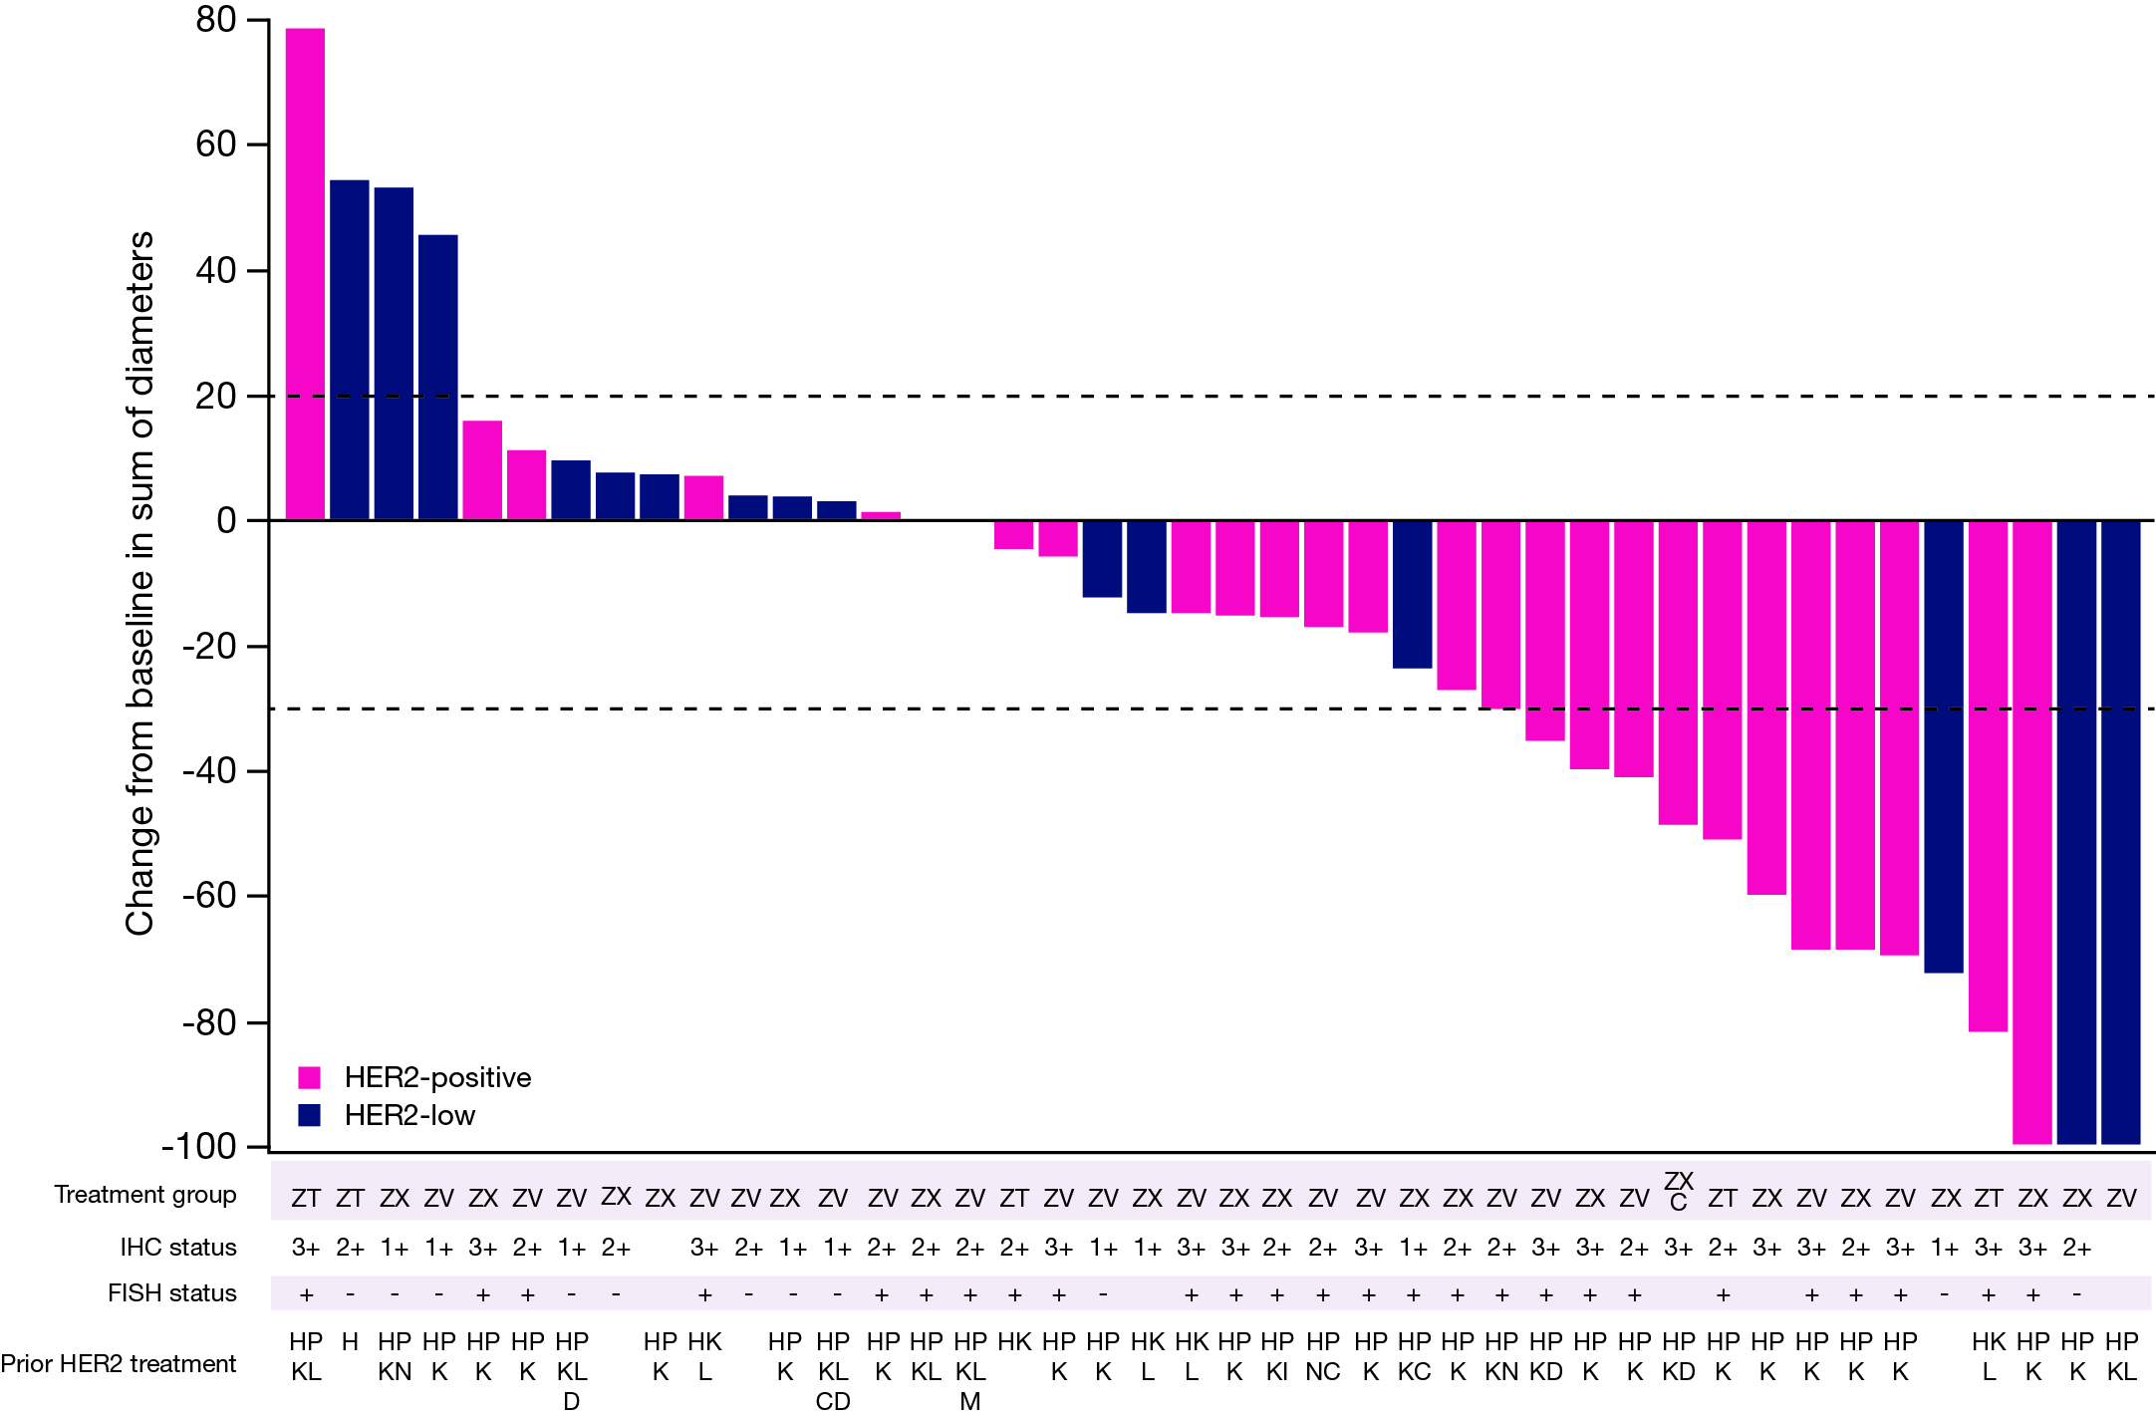
Antitumour activity (response-evaluable set)
 | HER2-Positive mBC (n=28) | HER2-Low mBC (n=15)
Confirmed ORR, % (n) [95% CI] IHC 3+ IHC 2+/FISH+ | 43% (n=12) [24, 63] 53% (n=8) [27, 79] 31% (n=4) [9, 61] | 20% (n=3) [4, 48] - -
Confirmed BOR,ª % (n) Complete response Partial response Stable disease Progressive disease | 0% (n=0) 43% (n=12) 46% (n=13) 11% (n=3) | 7% (n=1) 13% (n=2) 47% (n=7) 33% (n=5)
DCR^{a,b} % (n) 95% CI | 89% (n=25) 72, 98 | 67% (n=10) 38, 88
Median DoR, months (95% CI) | 14.8 (3.6, NE) | 10.4 (3.7, 26.0)
Data cut-off: 30 September 2024.
Only patients who had measurable lesions at baseline with evaluable responses were included.
ªProportion of patients with a BOR of complete or partial response or stable disease by RECIST version 1.1. ^{b}Includes complete response, partial response and stable disease of 24 weeks duration. ADC, antibody-drug conjugate; BOR, best overall response; CI, confidence interval; DCR, disease control rate; DoR, duration of response; FISH, fluorescence in situ hybridisation; HER2, human epidermal growth factor receptor 2; IHC, immunohistochemistry; mBC, metastatic breast cancer; NE, not estimable; ORR, objective response rate; RECIST, Response Evaluation Criteria in Solid Tumours.
Treatment group: C, tucatinib; T, paclitaxel; V, vinorelbine; X, capecitabine; Z, zanidatamab.
Prior HER2 treatment: C, tucatinib; D, trastuzumab deruxtecan; H, trastuzumab; I, investigational ADC; K, trastuzumab emtansine; L, lapatinib; M, margetuximab; N, neratinib; P, pertuzumab.
Erika Hamilton, MD

Slide 8
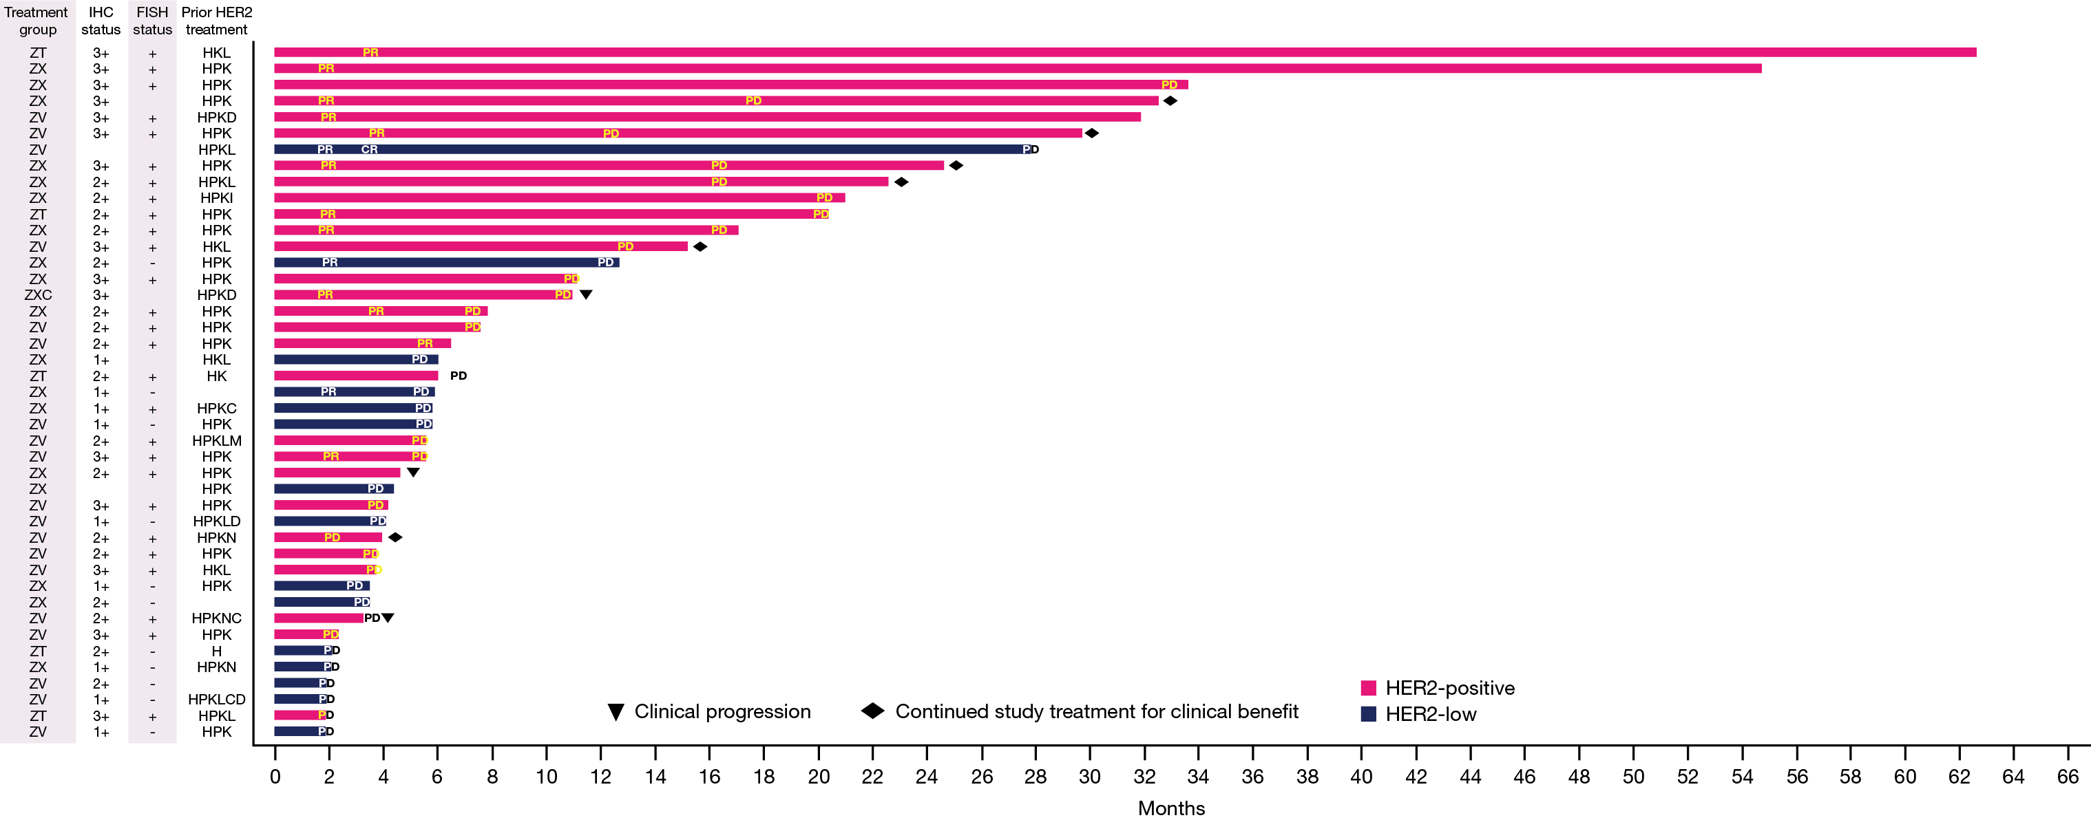
Follow-up duration and progression-free survival
Median follow-up duration: 6.2 (range: 1.9-62.6) months
All patients have discontinued the study
Median (95% CI) PFS:
HER2-positive: 10.4 (5.3, 16.4) months
HER2-low: 3.7 (1.8, 5.4) months
Treatment group: C, tucatinib; T, paclitaxel; V, vinorelbine; X, capecitabine; Z, zanidatamab.
Prior HER2 treatment: C, tucatinib; D, trastuzumab deruxtecan; H, trastuzumab; I, investigational ADC; K, trastuzumab emtansine; L, lapatinib; M, margetuximab; N, neratinib; P, pertuzumab.
Data cut-off: 30 September 2024. Patients who had baseline measurable disease with evaluable responses are reported.
ADC, antibody-drug conjugate; CI, confidence interval; CR, complete response; FISH, fluorescence in situ hybridisation; HER2, human epidermal growth factor receptor 2; IHC, immunohistochemistry; PD, progressive disease; PFS, progression-free survival; PR, partial response; RECIST, Response Evaluation Criteria in Solid Tumours.
Erika Hamilton, MD

Slide 9
conclusions
Zanidatamab plus chemotherapy had a manageable safety profile with good tolerability in heavily pretreated patients with HER2-expressing metastatic breast cancer, with no treatment-related deaths and low rate of zanidatamab discontinuation due to TRAEs
Promising antitumour activity was seen in heavily pretreated patients with HER2-positive metastatic breast cancer with prior HER2-targeted therapy (including trastuzumab, pertuzumab and T-DM1)
The confirmed ORR was 43% with a median duration of response >1 years, and the PFS was 10.4 months
Antitumour activity was also observed in patients with HER2-low metastatic breast cancer with a confirmed ORR of 20% (including 1 complete response)
The phase 3 EmpowHER-303 trial (NCT06435429) is ongoing and assessing zanidatamab plus chemotherapy in patients with metastatic breast cancer who are intolerant or whose disease has progressed on prior T-DXd
The authors would like to thank all the patients and their families, as well as all the investigators, clinical trial researchers, personnel and staff who contributed to or participated in the trial
HER2, human epidermal growth factor receptor 2; ORR, objective response rate; PFS, progression-free survival; T‑DM1, trastuzumab emtansine; T-DXd, trastuzumab deruxtecan; TRAE, treatment-related adverse event.
Erika Hamilton, MD

