Slide 1
Safety and efficacy of lurbinectedin plus atezolizumab as second-line treatment for advanced small-cell lung cancer: Results of the 2SMALL phase 1/2 study
Santiago Ponce Aix¹, Alejandro Navarro², Maria Eugenia Olmedo García³, Laura Mezquita⁴, Margarita Majem⁵, David Vicente⁶, Reyes Bernabé⁷, Alba Moratiel Pellitero⁸, Manuel Cobo⁹, Javier De Castro¹⁰, Silverio Ros¹¹, Marta Lopez Brea¹², Rosario G. Campelo¹³, Javier Baena¹, Helena Bote¹, Mercedes Herrera¹, Pedro Rocha², Jon Zugazagoitia¹, Enriqueta Felip², Luis Paz-Ares¹
¹Medical Oncology Department Hospital 12 de Octubre, Complutense University, H12O- CNIO Lung Cancer Unit, Fundación OncoSur, Madrid; ²Medical Oncology Department, Hospital Vall d´Hebron, Barcelona; ³Medical Oncology Department, Hospital Ramon y Cajal, Madrid; ⁴Hospital Clinic,Barcelona; ⁵Hospital de la Santa Creu i Sant Pau, Barcelona; ⁶Hospital Universitario Virgen Macarena, Seville; ⁷Hospital Universitario Virgen del Rocío, Seville; ⁸Hospital Clinico Lozano Blesa, Zaragoza; ⁹Hospital Regional Universitario de Málaga, Málaga; ¹⁰Hospital La Paz, Madrid; ¹¹Hospital Virgen de la Arrixaca, Murcia; ¹²Hospital Universitario Marqués de Valdecilla, Santander; ¹³Complejo Hospitalario Universitario de A Coruña, Coruña – all of them in Spain
This study has been sponsored by Fundación OncoSur
Santiago Ponce Aix MD

Slide 2
Declaration of Interest
Employment:
None
Consultant or Advisory Role:
Pfizer, Genentech-Roche, Boehringer-Ingelheim, AstraZeneca, Amgen, Ipsen,
Relay Therapeutics, Loxo-Lilly, Astellas, Johnson & Johnson, GSK
Stock Ownership:
None
Speaking:
Roche, AstraZeneca, Sanofi, Takeda, Pfizer
Travel Grants:
Roche, Johnson & Johnson
Santiago Ponce Aix MD

Slide 3
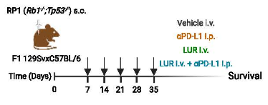
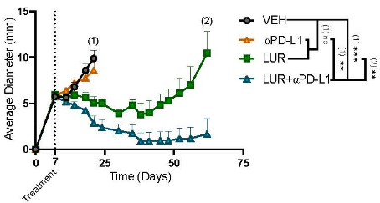
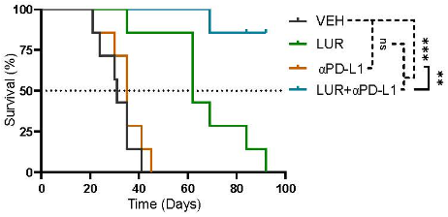
Background & Rationale
  Lurbinectedin has shown antitumor activity and manageable safety as second-line therapy in relapsed SCLC (ORR ~35%)¹
  The ATLANTIS trial showed that lurbinectedin plus doxorubicin had a better hematologic safety profile than topotecan, despite similar overall survival²
  Lurbinectedin and atezolizumab, both FDA-approved for SCLC, may act synergistically via transcriptional inhibition and immune modulation.³⁻⁴
  Phase I of the 2SMALL trial established established the RP2D, demonstrating promising tolerability and early antitumor signals⁵
Preclinical data support the synergy of lurbinectedin and anti–PD-L1 therapy
1. Trigo et al. Lancet Oncol. 2020 May;21(5):645-654.; 2. Ponce Aix et al , Lancet Respir Med. 2023 Jan;11(1):74-86;
3. Russo-Cabrera et al. ESMO 2023; 4. Russo-Cabrera et al. AACR 2025; 5. Ponce Aix at al, STIC 2021
Santiago Ponce Aix MD

Slide 4
Trial Design
Non-randomized, open-label phase II study of lurbinectedin plus atezolizumab as second-line therapy for advanced SCLC (NCT04253145)
Key Eligibility Criteria:
• Age ≥ 18 years
• Histologically/cytologically
confirmed advanced SCLC
• Progression to 1L platinum
based CT ± PD1/PDL1
• CTFI ≥30 days
• Measurable disease
• ECOG PS (0/1)
• Brain metastasis allowed if
treated and asymptomatic
RP2D
Primary endpoints
• Safety
• ORR (per RECIST v1.1)
Secondary endpoints
• Duration of response (DoR)
• Clinical benefit (CB) CR,
PR, SD ≥3 mo)
• PFS
• OS
• Others: PK, PGt and PGx
Cohort 1: IO-naïve
Lurbinectedin 3.2 mg/m² IV Q3W
+
Atezolizumab 1200 mg IV Q3W
(with prophylactic G-CSF)
SCLC Progression after 1L CT±PD1/PDL1
Cohort 2: IO-experienced
Phase II included two predefined groups based on platinum sensitivity: platinum-sensitive (CTFI ≥90 days) and platinum-resistant (CTFI 30 to <90 days). Patients with platinum-refractory disease (CTFI <30 days) were excluded.
Sample size (~160) based on ORR as primary endpoint; power 80%, α=0.05.
Data cut-off: May 31, 2024
Santiago Ponce Aix MD

Slide 5
Baseline characteristics
 | Cohort 1 IO-naïve (n=68) | Cohort 2 IO-experienced (n= 83) |  | Platinum - sensitive CTFI ≥90 days (n=92) | Platinum - resistant CTFI 30 to <90 days (n=59)
Age (median P25, P75) | 66 (60, 72) | 64 (58.5, 71.5) |  | 65 (59, 72) | 64 (59, 71.50)
> 75 years | 6 (8.82%) | 8 (9.64%) |  | 7 (7.61%) | 7 (11.86%)
Sex, Female, n (%) | 25 (36.76%) | 32 (38.55%) |  | 33 (35.87%) | 24 (40.68%)
Smoking status
Current smoker, n (%) | 23 (33.82%) | 27 (32.93%) |  | 32 (34.78%) | 18 (31.03%)
Former smoker, n (%) | 45 (66.18%) | 53 (64.63%) |  | 59 (64.13%) | 39 (67.24%)
ECOG PS1, n (%) | 48 (72.73%) | 62 (74.70%) |  | 62 (68.89%) | 48 (81.36%)
Stage at diagnosis, extensive n(%) | 41 (60.29%) | 78 (95.12%) |  | 69 (75%) | 50 (86.21%)
Liver metastases, n (%) | 24 (35.29%) | 40 (48.19%) |  | 38 (41.3%) | 26 (44.07%)
CNS metastases,n (%) | 23 (34.33%) | 19 (23.17%) |  | 29 (31.87%) | 13 (22.41%)
Best response to 1L, CR / PR, n (%) | 4 (6.15%) / 44 (67.69%) | 1 (1.25%) / 66 (82.5%) |  | 5 (5.62%) / 67 (75.28%) | 0 (0%) / 43 (76.79%)
Santiago Ponce Aix MD

Slide 6
ORR by RECIST v.1.1
Tumor response, n (%) | Cohort 1 IO-naïve (n=68) | Cohort 2 IO-experienced (n= 83) | TOTAL n=151 | Platinum - sensitive CTFI ≥90 days (n=92) | Platinum - resistant CTFI 30 to <90 days (n=59)
CR | 3 (4.41%) | 1 (1.20%) | 4 (2.65%) | 4 (4.35%) | 0 (0.00%)
PR | 27 (39.71%) | 30 (36.14%) | 57 (37.75%) | 36 (39.13%) | 21 (35.59%)
SD | 21 (30.88%) | 25 (30.12%) | 46 (30.46%) | 26 (28.26%) | 20 (33.90%)
PD | 13 (19.12%) | 24 (28.92%) | 37 (24.50%) | 22 (23.91%) | 15 (25.42%)
NA | 4 (5.88%) | 3 (3.61%) | 7 (4.64%) | 4 (4.35%) | 3 (5.08%)
ORR n, % (95% CI) | 30 44.12% (32.27-56.63 %) | 31 37.35% (27.18-48.70%) | 61 40.4% ( TBC-TBC) | 40 43.48% (33.30-54.20%) | 21 35.59% (23.87%-49.20%)
DCR (CR+PR+SD) | 51 (75%) | 56 (67.46%) | 107 (70.86%) | 66 (71.74%) | 41 (69.49%)
Patients with CR, PR, SD ≥3 mo CB (95% CI) | 21 30.88 (20.54-43.4) | 17 20.48 (12.71-31.04) | 38 51.36 (TBC-TBC) | 27 29.35 (20.55-39.9) | 11 18.64 (10.11-31.33)
Primary objective has been achieved with 40.4% confirmed response rate
Median of follow up time of patients is 9.13 months
Santiago Ponce Aix MD

Slide 7
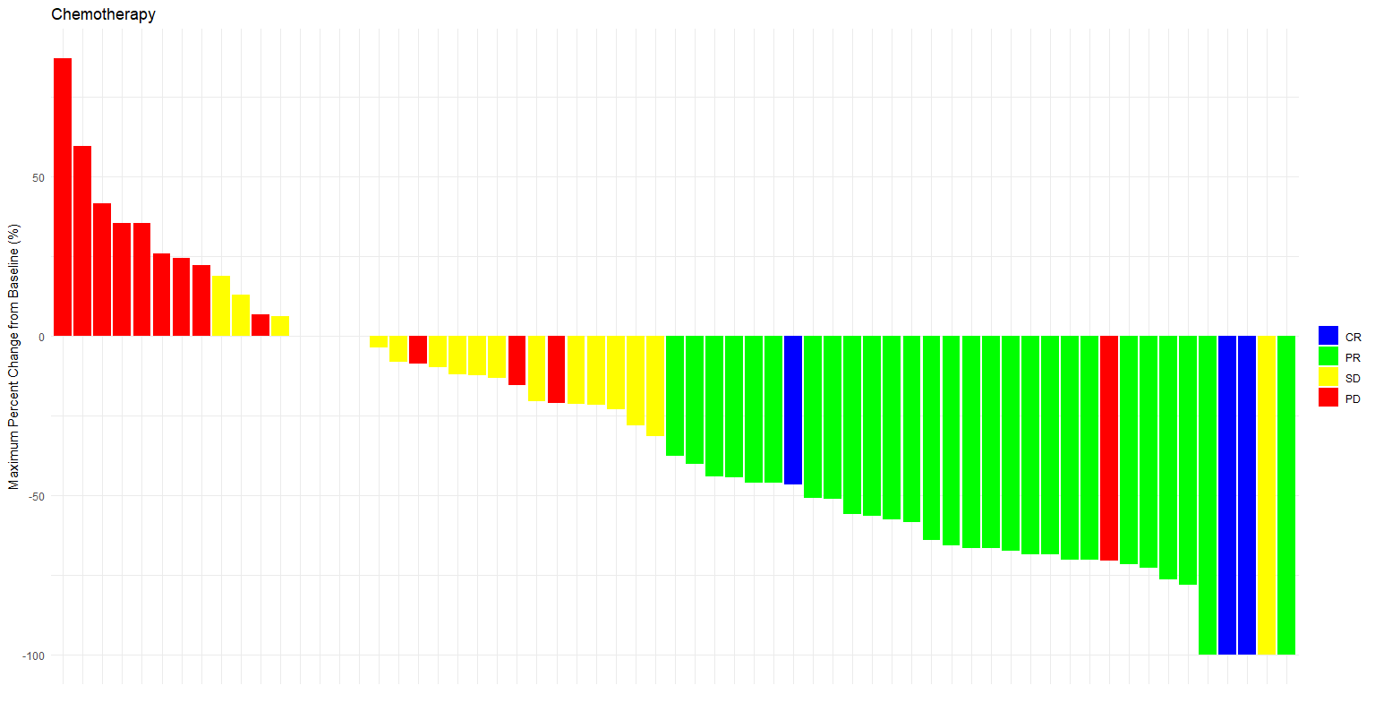
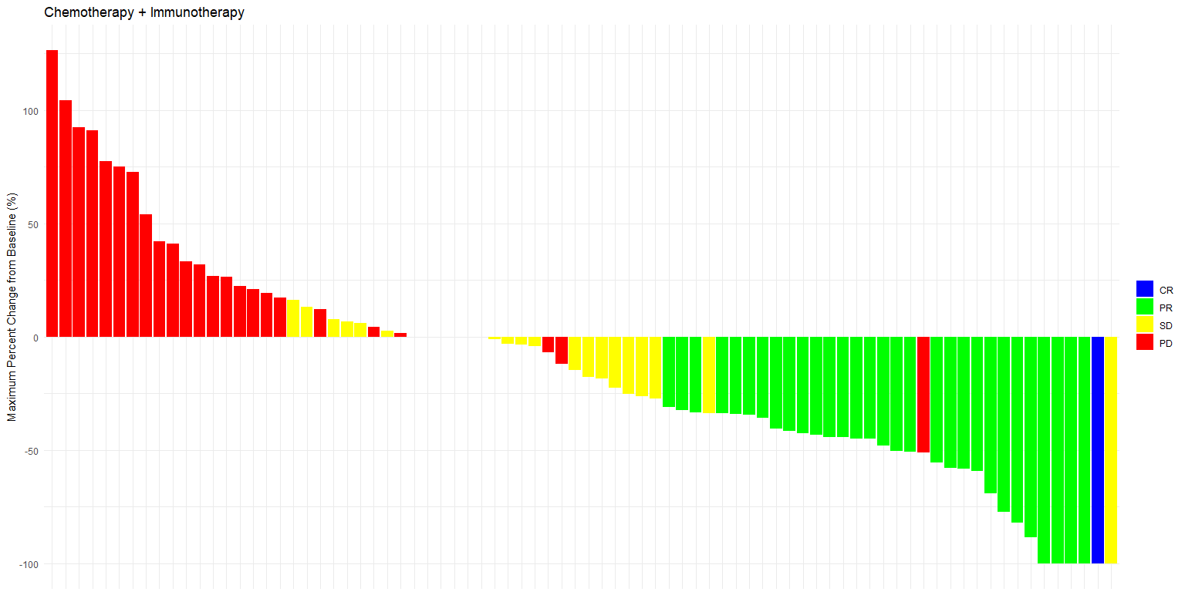
Depth and duration of response
Cohort 1: IO-naïve
Cohort 2: IO-experienced
DoR, mo (95% CI) | Cohort 1 IO-naïve (n=68) | Cohort 2 IO-experienced (n= 83) | TOTAL n=151 | Platinum - sensitive CTFI ≥90 days (n=92) | Platinum - resistant CTFI 30 to <90 days (n=59)
Median | 5.6 (3.87 - 7.50) | 3.97 (3 - 4.40) | 4.12 (3.30 - 5.60) | 4.40 (3.30 - 7.07) | 4.07 (2.93 - 6.03)
Santiago Ponce Aix MD

Slide 8
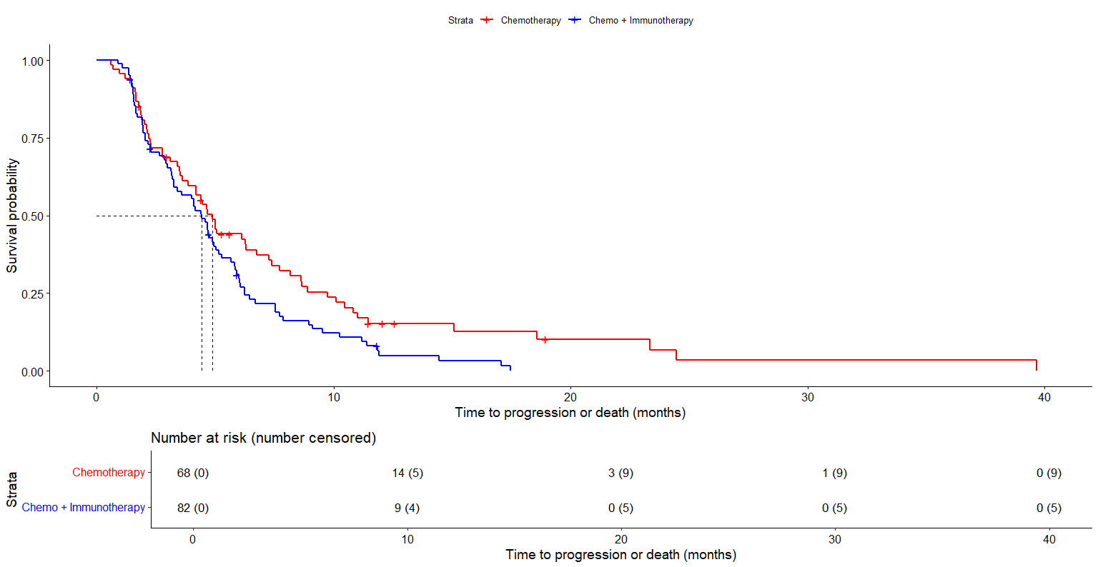
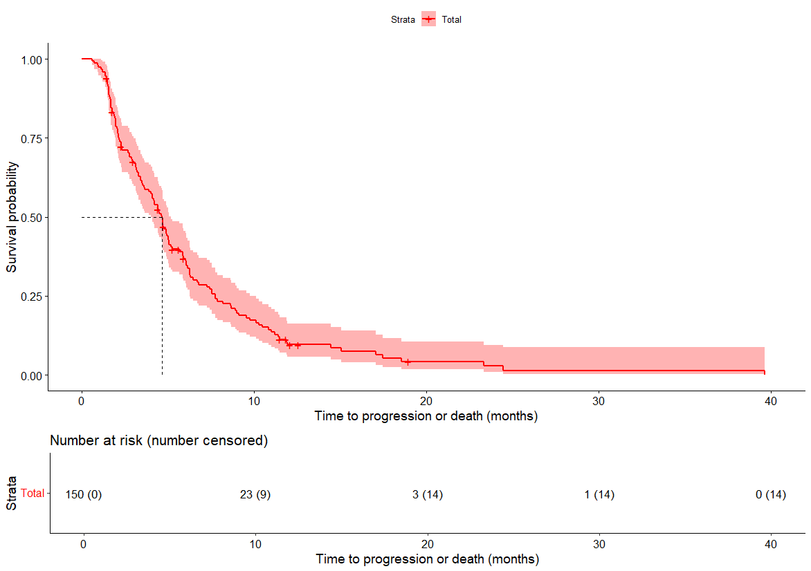
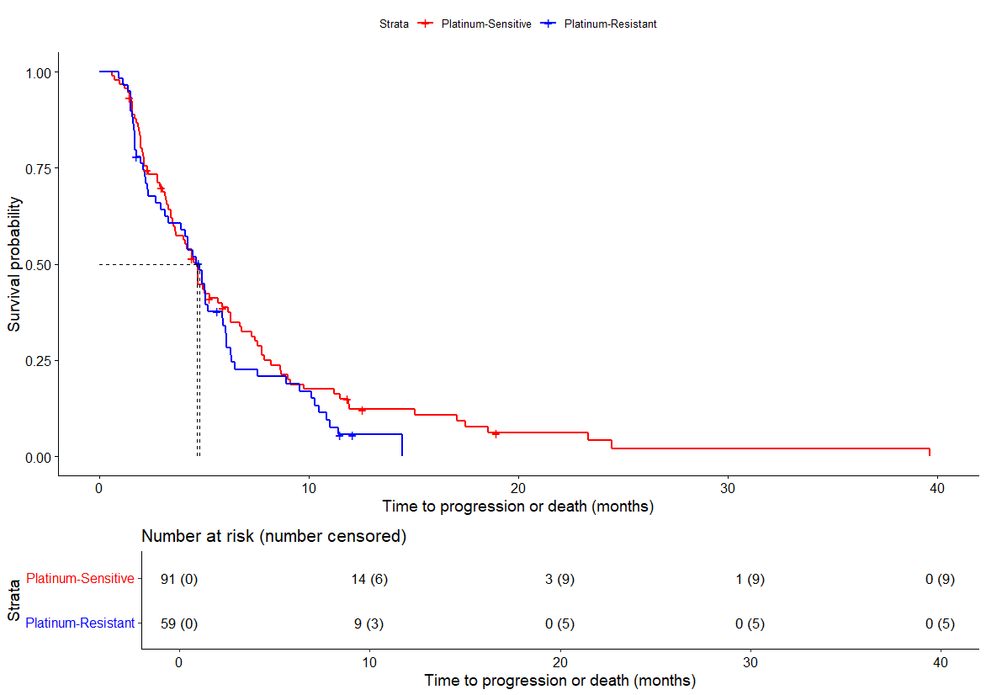
PFS
IO - Naïve: 4.9 mo (95% CI 3.87 - 7.27)
IO - Experienced: 4.43 mo (95% CI 3.27 - 5.17)
Median PFS: 4.63 mo (95% CI 4-5.17)
CTFI ≥90 d: 4.63 mo (95% CI 3.60 - 6.13)
CTFI 30 to <90 d: 4.77 mo (95% CI 3.27 - 5.90)
Santiago Ponce Aix MD
Subgroup analyses are descriptive; no formal comparisons were performed
Santiago Ponce Aix MD

Slide 9
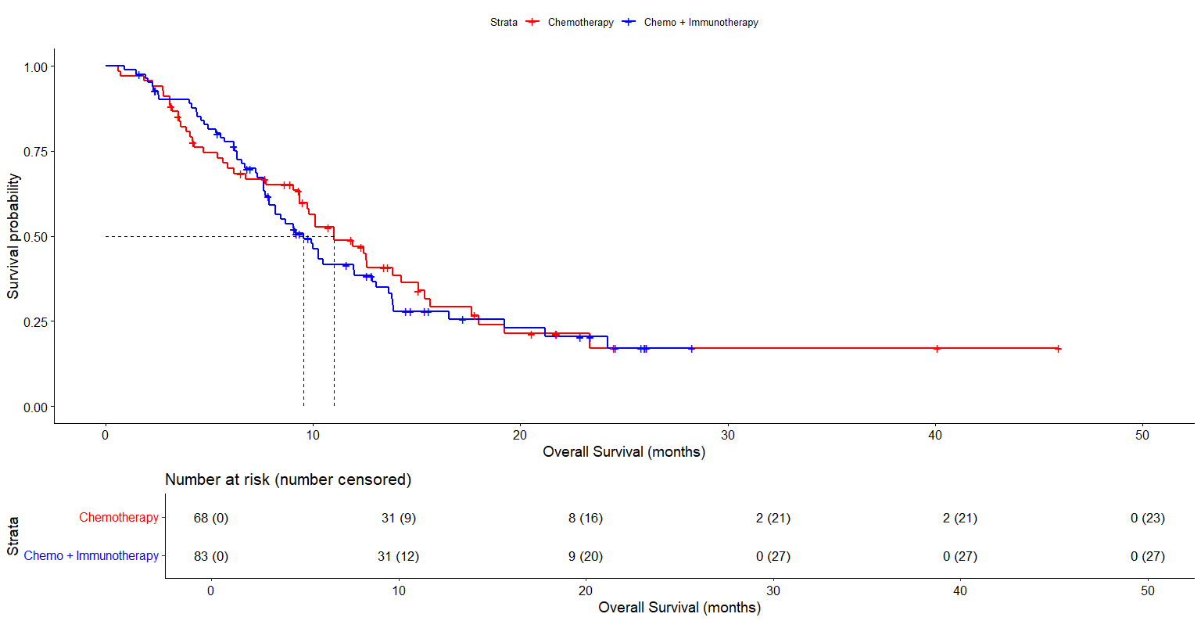
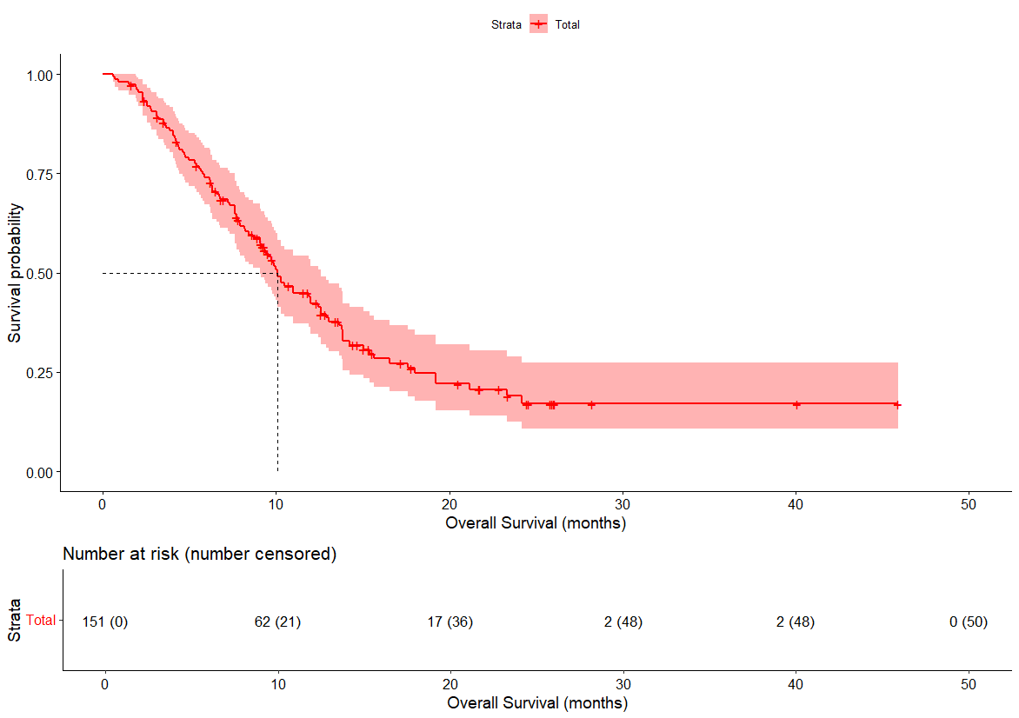
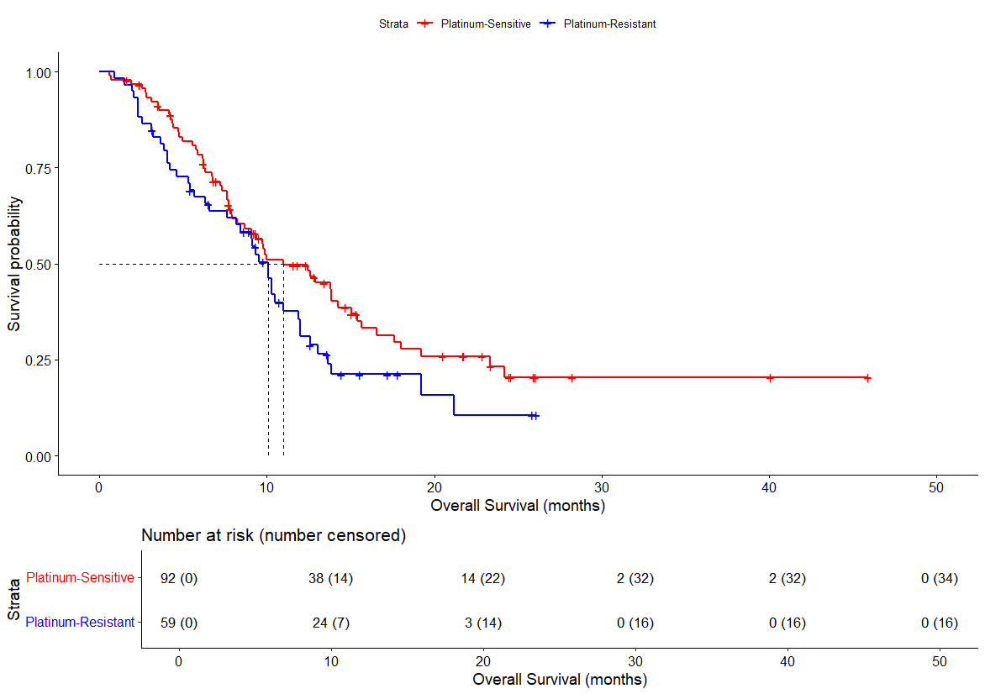
OS
IO - Naïve: 11mo (95% CI 9.37 - 15.07 )
IO - Experienced: 9.53 mo (95% CI 7.90 - 12.87)
Median OS: 10.10 mo (95% CI 9.07 - 12.57)
CTFI ≥90 d: 11 mo (95% CI 8.67 - 15.07 )
CTFI 30 to <90 d: 10.10 mo (95% CI 8.17 - 11.97)
Subgroup analyses are descriptive; no formal comparisons were performed
Santiago Ponce Aix MD

Slide 10
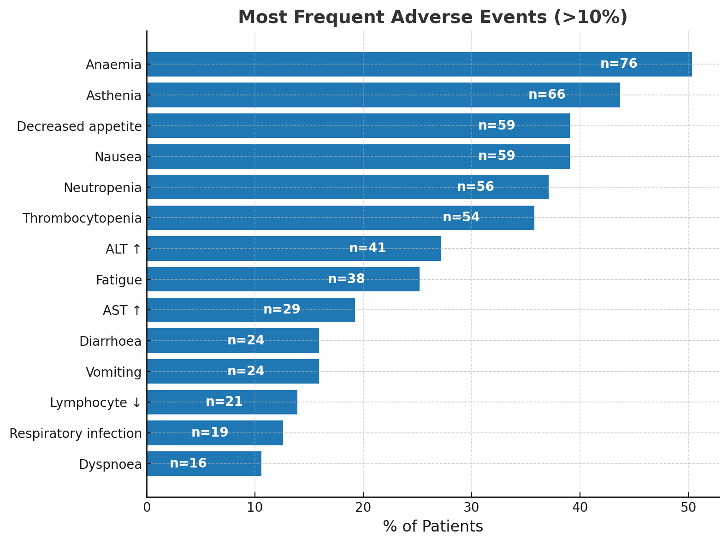
Safety summary
Category | n (%)
Any AE | 138 (91.39%)
Grade ≥3 AE | 78 (51.66%)
Grade ≥4 AE | 29 (19.21%)
Any Serious AE | 45 (29.8%)
Grade ≥3 serious AE | 43 (28.5%)
Grade ≥4 serious AE | 12 (8.0%)
AE leading to discontinuation | 18 (11.9%)
AE leading to death | 8 (5.3%)
Any TRAEs | 129 (85.43%)
Serious TRAES | 8 (5.3%)
Any serious TRAEs leading to discontinuation | 2 (1.32%)
TRAEs - reletaded deatch | 0 (0%)
TRAEs leading to discontinuation | n (%)
Neutropenia | 2 (1.32%)
Asthenia | 1 (0.66%)
Hyperthyroidism | 1 (0.66%)
Lipase increased | 1 (0.66%)
Pneumonitis | 1 (0.66%)
Febrile neutropenia | 1 (0.66%)
Herpes zoster | 1 (0.66%)
Hematological TRAEs | n (%)
Neutropenia grade ≥3 | 22 (14.57%)
Thrombocytopenia grade ≥3 | 10 (6.62%)
Febrile neutropenia grade ≥3 | 2 (1.32%)
Anaemia grade ≥3 | 1 (0.66%)
Santiago Ponce Aix MD

Slide 11
Conclusions
The trial met its primary endpoint, achieving an investigator-assessed ORR of 40.4% with the combination of Lurbinectedin plus Atezolizumab
Clinical benefit observed with median PFS of 4.6 months and median OS of 10.1 months
Activity observed across clinically relevant subgroups, including IO-pretreated and platinum-resistant patients
Safety profile manageable, with no treatment-related deaths and low discontinuation rates
2SMALL, an academically sponsored phase II trial, defined the regimen now under evaluation in the IMforte phase III — a timely reminder that even big trials often begin with something 2SMALL
Santiago Ponce Aix MD

Slide 12
Acknowledgements and Funding
With gratitude to…
All the patients and their families for their generosity and trust
Investigators and caregivers for their commitment and dedication
The Fundación OncoSur team for making this study possible
This study was funded by Pharmamar and Roche
Santiago Ponce Aix MD

