Slide 1
Long-term outcomes and overall survival for zanidatamab + chemotherapy in HER2-positive advanced or metastatic gastroesophageal adenocarcinoma: 4-year follow-up of a phase 2 trial
Elena Elimova,¹ Jaffer Ajani,² Howard Burris,³ Crystal S. Denlinger,⁴ Syma Iqbal,⁵ Yoon-Koo Kang,⁶ Jwa Hoon Kim,⁷ Keun-Wook Lee,⁸ Bruce Lin,⁹ Rutika Mehta,¹⁰ Do-Youn Oh,¹¹ Sun Young Rha,¹² Chengzhi Xie,¹³ Diana Shpektor,¹³ Phillip M. Garfin,¹³ Geoffrey Ku¹⁴
¹Princess Margaret Cancer Centre, Toronto, ON, Canada; ²The University of Texas MD Anderson Cancer Center, Houston, TX, USA; ³Sarah Cannon Research Institute, Nashville, TN, USA; ⁴Fox Chase Cancer Center, Philadelphia, PA, USA; ⁵University of Southern California, Los Angeles, CA, USA; ⁶Asan Medical Center, University of Ulsan College of Medicine, Seoul, South Korea; ⁷Korea University College of Medicine, Korea University Anam Hospital, Seoul, South Korea; ⁸Seoul National University Bundang Hospital, Seoul National University College of Medicine, Seongnam, South Korea; ⁹Virginia Mason Medical Center, Seattle, WA, USA; ¹⁰ Weill Cornell Medicine/New York Presbyterian Hospital, New York, NY, USA; ¹¹Seoul National University Hospital, Seoul National University College of Medicine, Seoul, South Korea; ¹²Yonsei Cancer Center, Yonsei University College of Medicine, Seoul, South Korea; ¹³Jazz Pharmaceuticals, Palo Alto, CA, USA; ¹⁴Memorial Sloan Kettering Cancer Center, New York, NY, USA.
Presenting author’s disclosures:
E Elimova has served as a member of the steering committee for Jazz Pharmaceuticals; has participated in consulting or advisory roles for AbbVie, Astellas Pharma, AstraZeneca, BeiGene, Signatera, and Viracta Therapeutics and for Adaptimmune, Bristol Myers Squibb, Jazz Pharmaceuticals, and Zymeworks on behalf of her institution; has received honoraria from Daiichi-Sankyo/AstraZeneca and Roche Canada; has received institutional research funding from Amgen, Arcus Biosciences, AstraZeneca Canada, Bold Therapeutics,
Bristol Myers Squibb, Jazz Pharmaceuticals, and Zymeworks; and has a family member who is employed by Merck.
Elena Elimova, MD, MSc
Abstract #4013
Notes:
Cross checked with the submitted abstract

Slide 2
Key Takeaways
In this phase 2 trial, 1L zanidatamab + chemotherapy showed clinically meaningful
antitumor activity (confirmed ORR, 76%) and promising survival outcomes
(median OS, 36.5 months) for HER2-positive advanced GEA, especially in patients with centrally confirmed HER2-positive tumors
The safety profile of zanidatamab + chemotherapy was generally manageable with
antidiarrheal prophylaxis, along with no treatment-related deaths and a low rate of
treatment-related discontinuations
Zanidatamab is a promising dual HER2-targeted bispecific antibody that appears to have a role in the treatment of patients with untreated HER2-positive advanced GEA
1L, first-line; GEA, gastroesophageal adenocarcinoma; HER2, human epidermal growth factor receptor 2; ORR, objective response rate; OS, overall survival.
Elena Elimova, MD, MSc

Slide 3
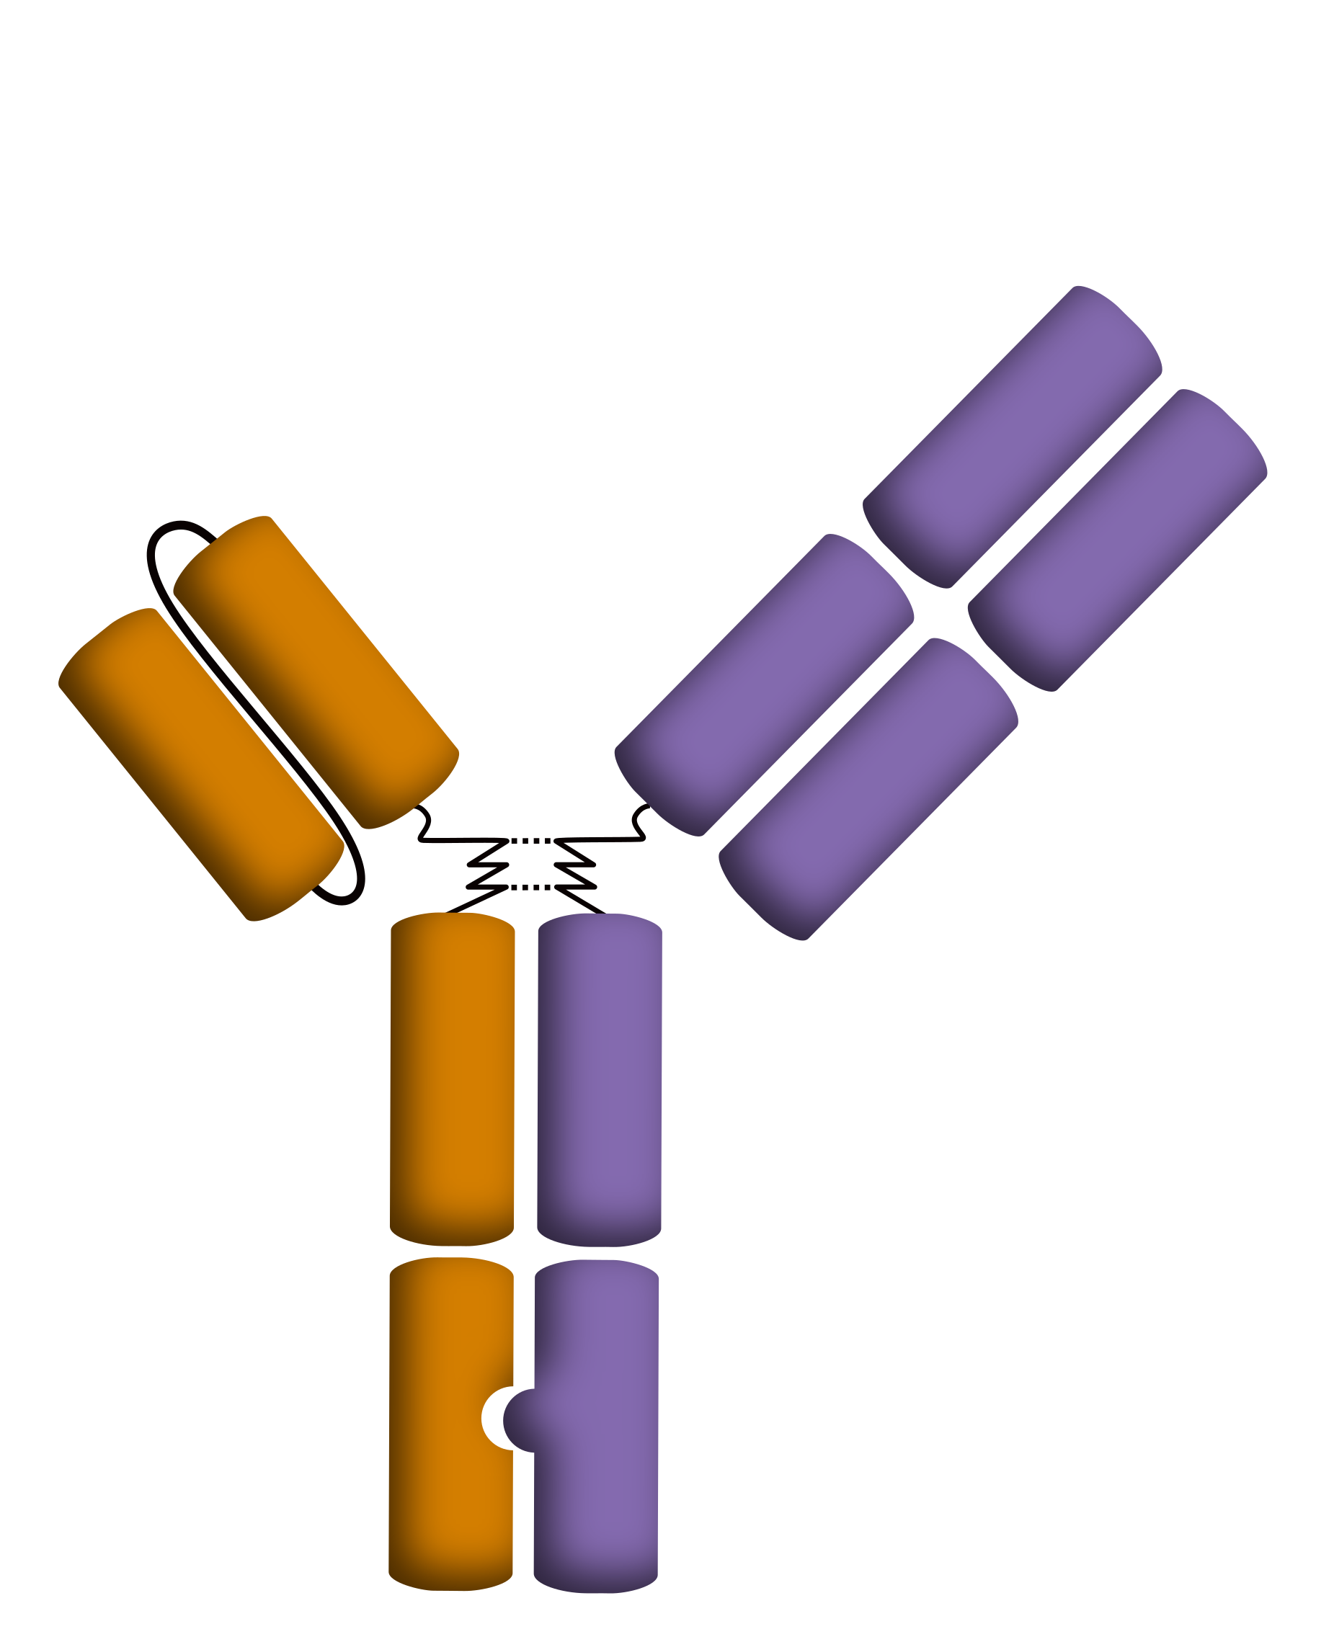
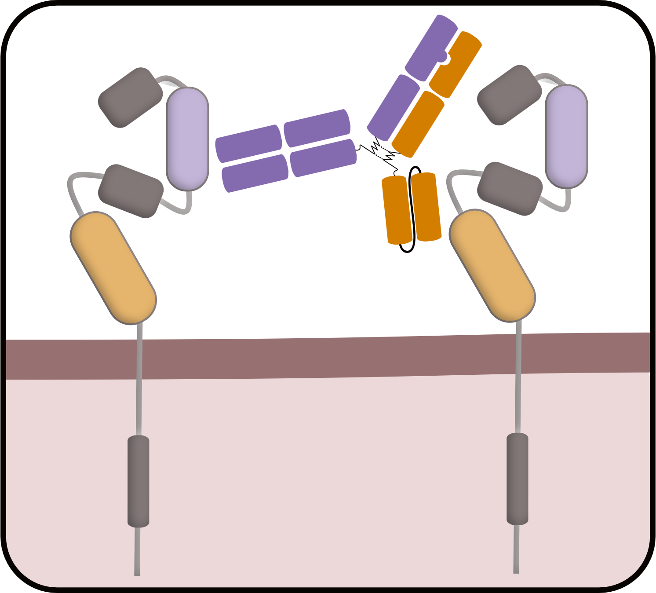
Background
Zanidatamab
HER2 ECD2
binding region
The current 1L SoC for patients with HER2-positive metastatic GEA is trastuzumab + chemotherapy ± pembrolizumab
  Despite recent advancements, median OS associated with 1L SoC is 13.8-20.5 months^{2,3}
Zanidatamab is a dual HER2-targeted bispecific antibody that drives multiple antitumor MOAs, including¹:
  Facilitation of HER2 internalization and subsequent degradation
  Reduction of HER2 on the cell surface
  Inhibition of HER2 signaling pathways
  Activation of immune-mediated effects (CDC, ADCC, and phagocytosis)
HER2 ECD4
binding region
Fc
HER2
HER2
II
II
IV
IV
Extracellular
Intracellular
ADCC, antibody‑dependent cellular cytotoxicity; CDC, complement-dependent cytotoxicity; ECD, extracellular domain; MOA, mechanism of action; SoC, standard of care.
1. Weisser N, et al. Nat Commun. 2023;14(1):1394. 2. Bang YJ, et al. Lancet. 2010;376(9742):687-697. 3. Janjigian YY, et al. Lancet. 2023;402(10418):2197-2208.
Elena Elimova, MD, MSc
Notes:
Here, we report a 4-year follow-up, and the first report of both median OS and translational data, from this phase 2 trial of zanidatamab + chemotherapy in 1L advanced HER2-positive GEA

Slide 4
Methods
Eligibility criteria
Aged ≥18 years at the time of signing informed consent
HER2-expressing advanced or metastatic GEA
  Part 1: IHC 3+ or IHC 2+ regardless of FISH status per local or central assessment
  Part 2: IHC 3+ or IHC 2+/FISH+ per central assessment
Measurable disease per RECIST v1.1¹
Baseline ECOG PS 0 or 1
No prior HER2-targeted treatment
Single arm trial: Zanidatamab + clinician’s choice of chemotherapy
Zanidatamab^{a,b}
IV Q3W + CAPOX^{c}
Zanidatamab^{a,b}
IV Q3W + FP^{d}
Zanidatamab^{b,e}
IV Q2W + mFOLFOX6^{f}
After the first 25 patients were enrolled and treated, antidiarrheal prophylaxis^{g} was added for all subsequent patients
Primary endpoint
Investigator-assessed confirmed ORR
Select secondary endpoints
DOR
PFS
OS
Rate and severity of AEs
Exploratory endpoint
Potential biomarkers for prognostic prediction
CT/MRI scans Q6W per RECIST v1.1¹
Plasma ctDNA samples at baseline and on treatment using NGS testing (Guardant360)
ªZanidatamab 30 mg/kg, 1800 mg (patients <70 kg) or 2400 mg (patients ≥70 kg); ^{b}Chemotherapy was required for 6 cycles except for intolerability or disease progression. Patients who discontinued chemotherapy due to reasons not related to zanidatamab toxicity without disease progression could continue treatment with zanidatamab monotherapy; ^{c}Capecitabine 1000 mg/m² PO BID on days 1-14 Q3W + oxaliplatin 130 mg/m² IV Q3W; ^{d}Cisplatin 80 mg/m² IV Q3W + 5-FU 800 mg/m²/day IV on days 1-5 Q3W; ^{e}Zanidatamab 20 mg/kg, 1200 mg (patients <70 kg) or 1600 mg (patients ⩾70 kg) IV Q2W; ^{f}Leucovorin 400 mg/m² IV Q2W + oxaliplatin 85 mg/m² IV Q2W + 5-FU 1200 mg/m²/day continuous IV infusion for 48 hours Q2W; ^{g}Loperamide 4 mg BID starting on cycle 1 day 1 and continuing for ≥7 days.
5-FU, 5-fluorouracil; AE, adverse event; BID, twice daily; CAPOX, capecitabine plus oxaliplatin; CT, computed tomography; ctDNA, circulating tumor DNA; DOR, duration of response; ECOG PS, Eastern Cooperative Oncology Group performance status; FP, 5-FU plus cisplatin; FISH, fluorescence in situ hybridization; GEA, gastroesophageal adenocarcinoma; IHC, immunohistochemistry; IV, intravenous; mFOLFOX6, modified 5-FU plus oxaliplatin; MRI, magnetic resonance imaging;
PFS, progression-free survival; PO, by mouth; Q2W, every 2 weeks; Q3W, every 3 weeks; Q6W, every 6 weeks; RECIST v1.1, Response Evaluation Criteria in Solid Tumors version 1.1.
1. Eisenhauer EA et al. Eur J Cancer. 2009;45(2):228-247.
Elena Elimova, MD, MSc
Notes:
Addendum to footnote a: Chemotherapy could be continued, attenuated (5-FU or capecitabine could be maintained if oxaliplatin was discontinued due to toxicity; however, if 5-FU or capecitabine was discontinued, oxaliplatin should have been discontinued) or discontinued per the investigator’s and patient’s discretion

Slide 5
Baseline Demographics and Disease Characteristics
 | All Patients (N = 46)
Age, median, years (range) | 58 (26-82)
Male,ª n (%) | 39 (85)
Race,^{b} n (%) White Asian Unknown | 28 (61) 17 (37) 1 (2)
Anatomical subtype, n (%) Gastric GEJ Esophageal | 19 (41) 16 (35) 11 (24)
ECOG PS, n (%) 1 | 20 (43)
Stage at initial diagnosis, n (%) III/IV | 42 (91)
Measurable disease, n (%) | 43 (93)
ccHER2-positive,^{c} n (%) IHC 2+/FISH+ IHC 3+ | 5 (11) 36 (78)
On Study Regimen Received, n (%) | All Patients (N = 46)
Zanidatamab + CAPOX | 20 (43)
Zanidatamab + mFOLFOX6 | 24 (52)
Zanidatamab + FP | 2 (4)
At data cutoff (July 28, 2024), median (range) follow-up:
48 (29-59) months
41/46 (89%) patients had tumors that were confirmed to be
HER2-positive by central laboratory assessment (ccHER2+)
  4 patients with IHC 2+ or IHC 3+ tumors by local assessment were subsequently assessed as IHC 0 or IHC 1+ by
  central laboratory assessment
  1 patient had IHC 3+ tumors by local assessment and did not have central assessment completed
ªSelf-reported; ^{b}Self-reported; patients could have reported ≥1 race category; ^{c}Defined as IHC 3+ or IHC 2+ with FISH+ by central assessment.
GEJ, gastroesophageal junction.
Elena Elimova, MD, MSc

Slide 6
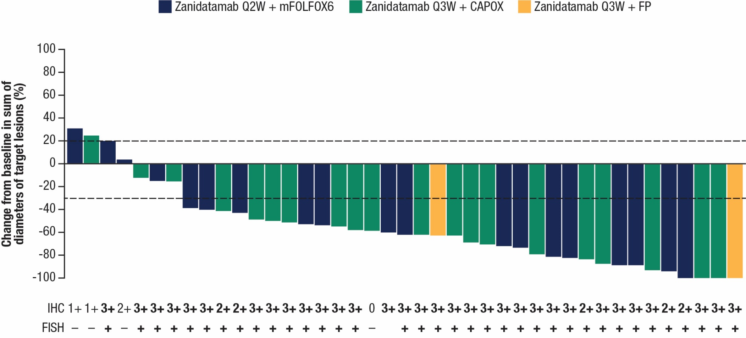
Antitumor Activity (Response-Evaluable Patients)
Nearly all response-evaluable patients (90%) had a decrease in target lesions from baseline
 | All Patients (N = 42) | ccHER2+ Subset (n = 37)
cORR n (%) 95% CI | 32 (76) 60, 88 | 31 (84) 68, 94
cBOR,ª n (%)
CR | 3 (7) | 3 (8)
PR | 29 (69) | 28 (76)
SD | 5 (12) | 4 (11)
PD | 5 (12) | 2 (5)
DCR^{b} n (%) 95% CI | 37 (88) 74, 96 | 35 (95) 82, 99
CBR^{c} n (%) 95% CI | 33 (79) 63, 90 | 32 (86) 72, 96
NA
Response-evaluable patients were those who underwent at least 1 post-baseline response assessment per RECIST v1.1 or discontinued treatment due to clinical progression or death. One patient in the response-evaluable analysis set had a new lesion detected (deemed PD) on an unscheduled visit before the first scheduled tumor scan; however, measurements of this lesion were not available. Hence, this patient was not included in the waterfall plot given the missing post-baseline measurements.
ªBOR is defined as the best response documented between the date of first dose and the date of investigator-assessed objectively documented progression, the date of subsequent anticancer therapy, any-cause death, loss to follow-up, or study discontinuation, whichever occurred first. Confirmed BOR is the BOR of a CR or PR per RECIST v1.1 confirmed ≥28 days after the first documentation; ^{b}Disease control was defined as a BOR of SD or confirmed CR or PR; ^{c}Defined as achieving a BOR of SD, non-CR, or non-PD for ≥24 weeks or confirmed CR or PR.
BOR, best overall response; cBOR, confirmed BOR; CBR, clinical benefit rate; CI, confidence interval; cORR, confirmed ORR; CR, complete response; DCR, disease control rate; PD, progressive disease; PR, partial response; NA, not available; SD, stable disease.
Elena Elimova, MD, MSc

Slide 7
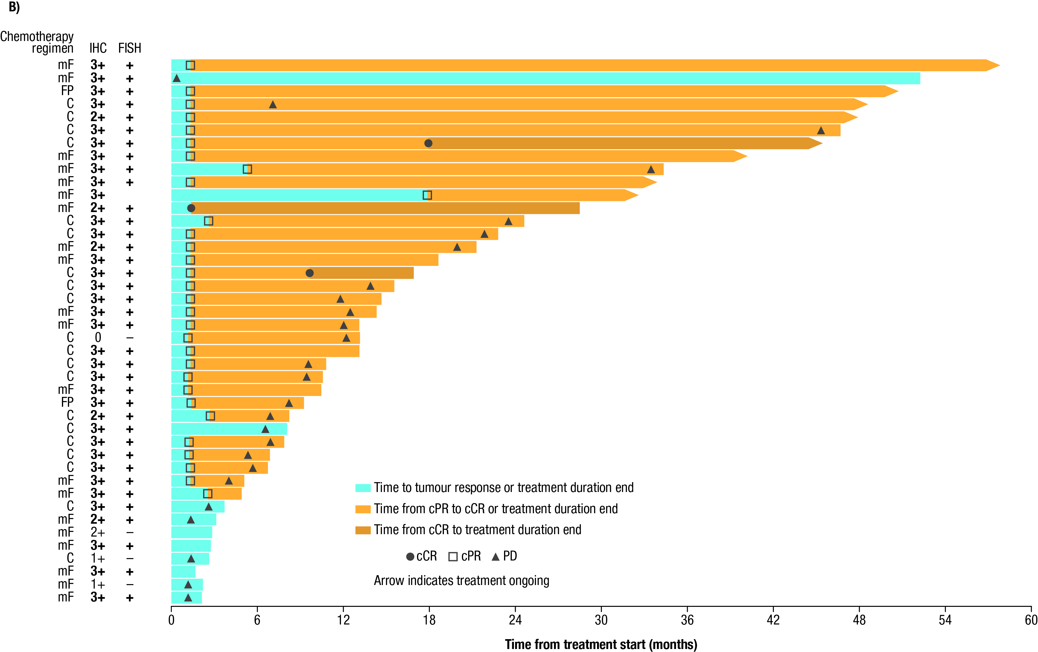
Duration of Treatment and Response
NA
 | All Patientsª (N = 42) | ccHER2+ Subsetª (n = 37)
Median time to first confirmed response,^{b,c} months (range) | 1.3 (1.3-1.4) | 1.3 (1.3-1.4)
Duration of response,^{c} months Median (95% CI) ≥12 months rate,^{d} % (95% CI) ≥24 months rate,^{d} % (95% CI) | 18.7 (10.4, 44.1) 57 (37, 72) 40 (22, 58) | 20.4 (8.3, 44.1) 59 (39, 74) 41 (22, 59)
At data cutoff, zanidatamab treatment was ongoing in 8 (17%) of patients (all with ccHER2+ tumors)
19 (41%) patients overall and 18 (44%) patients in the ccHER2+ subset were in survival follow-up
Time from treatment start (months)
ªFrom the response-evaluable analysis set; response-evaluable patients were those who underwent at least 1 post-baseline response assessment per RECIST v1.1 or discontinued treatment due to clinical progression or death. One patient in the response-evaluable analysis set had a new lesion detected (deemed PD) on an unscheduled visit before the first scheduled tumor scan; however, measurements of this lesion were not available. Hence, this patient was not included in the waterfall plot given the missing post-baseline measurements. ^{b}Defined as the time from first dose to the first documented complete response or partial response per RECIST v1.1 confirmed ≥28 days after the first observed response; ^{c}Assessed in the 32 patients with a cCR or cPR (ccHER2+, n=31); ^{d}Kaplan-Meier probabilities.
C, capecitabine plus oxaliplatin; ccHER2+, centrally confirmed HER2-positive; cCR, confirmed complete response; cPR, confirmed partial response; mF, modified 5-fluorouracil/leucovorin plus oxaliplatin; NA, not available; PD, progressive disease.
Elena Elimova, MD, MSc

Slide 8
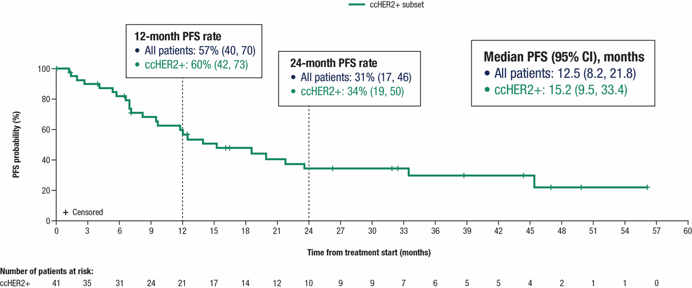
Progression-Free Survival
ccHER2+ subset
12- and 24-month PFS rates are Kaplan-Meier probabilities and reported along with 95% CIs.
Elena Elimova, MD, MSc

Slide 9
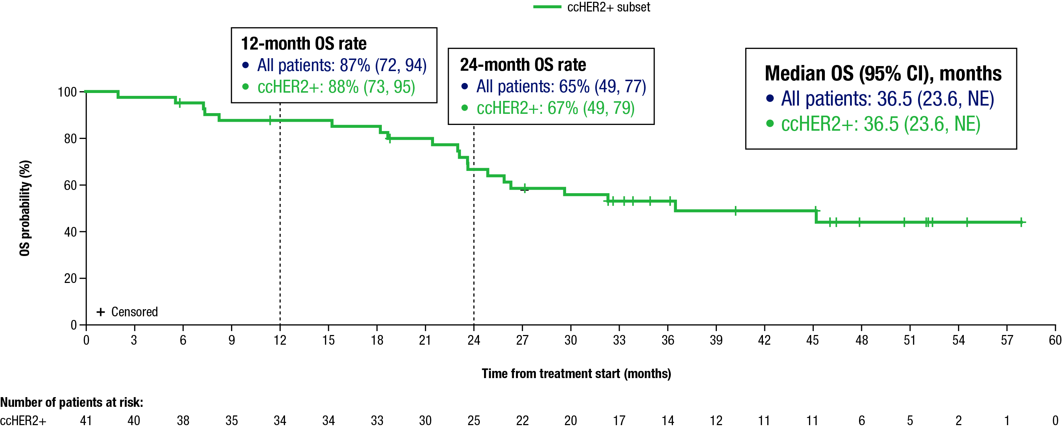
Overall Survival
ccHER2+ subset
12- and 24-month OS rates are Kaplan-Meier probabilities and reported along with 95% CIs.
NE, not estimable.
Elena Elimova, MD, MSc

Slide 10
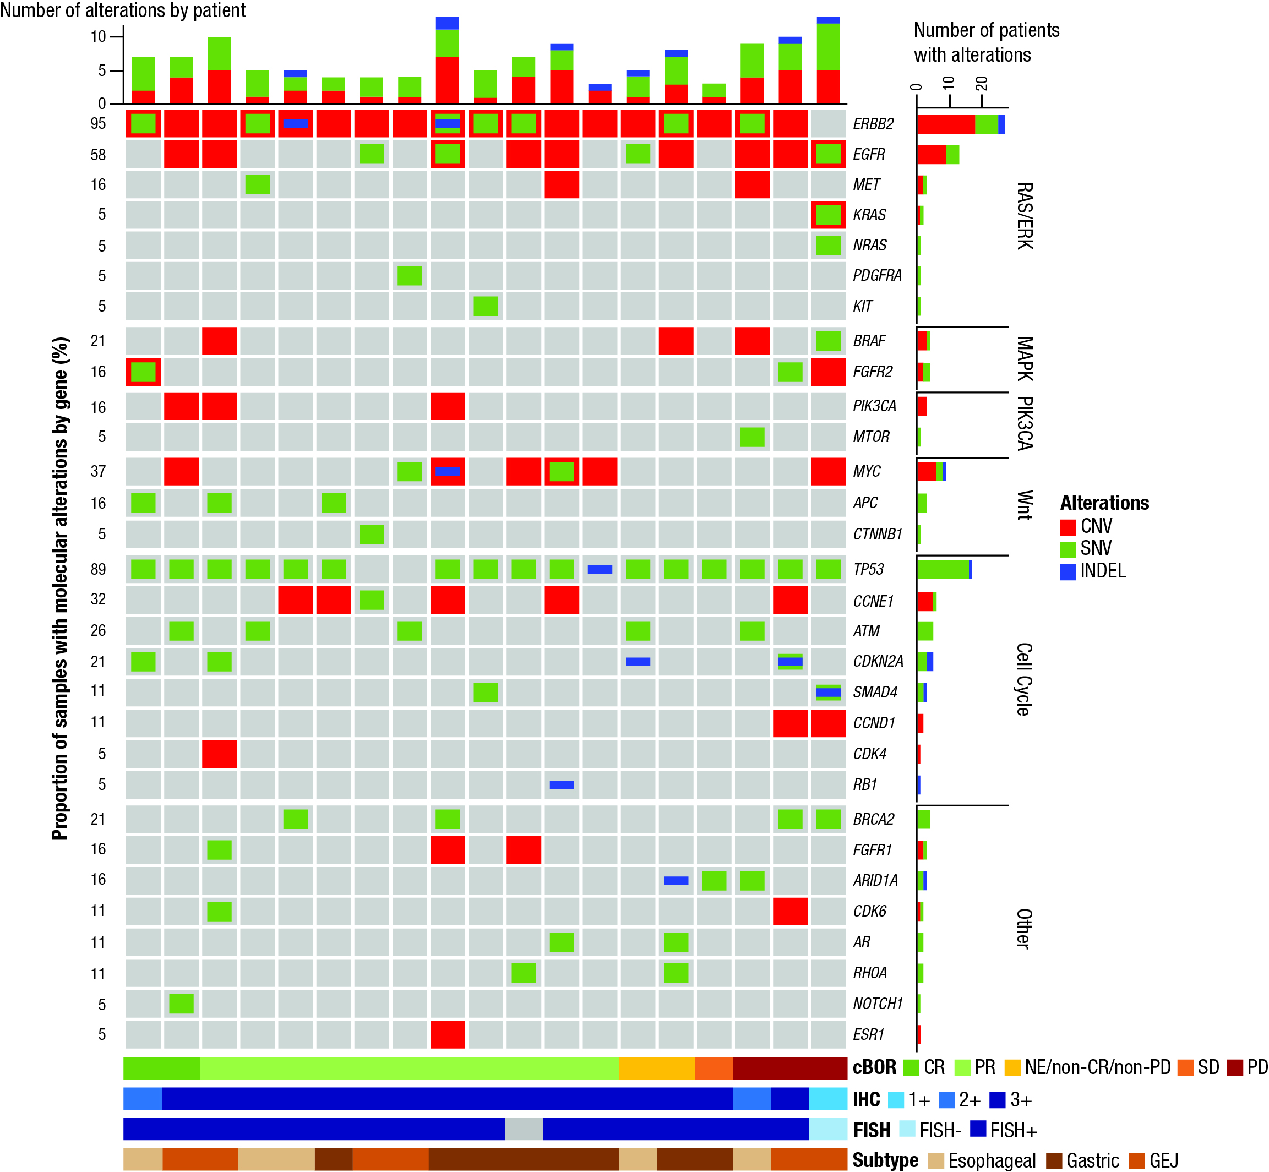
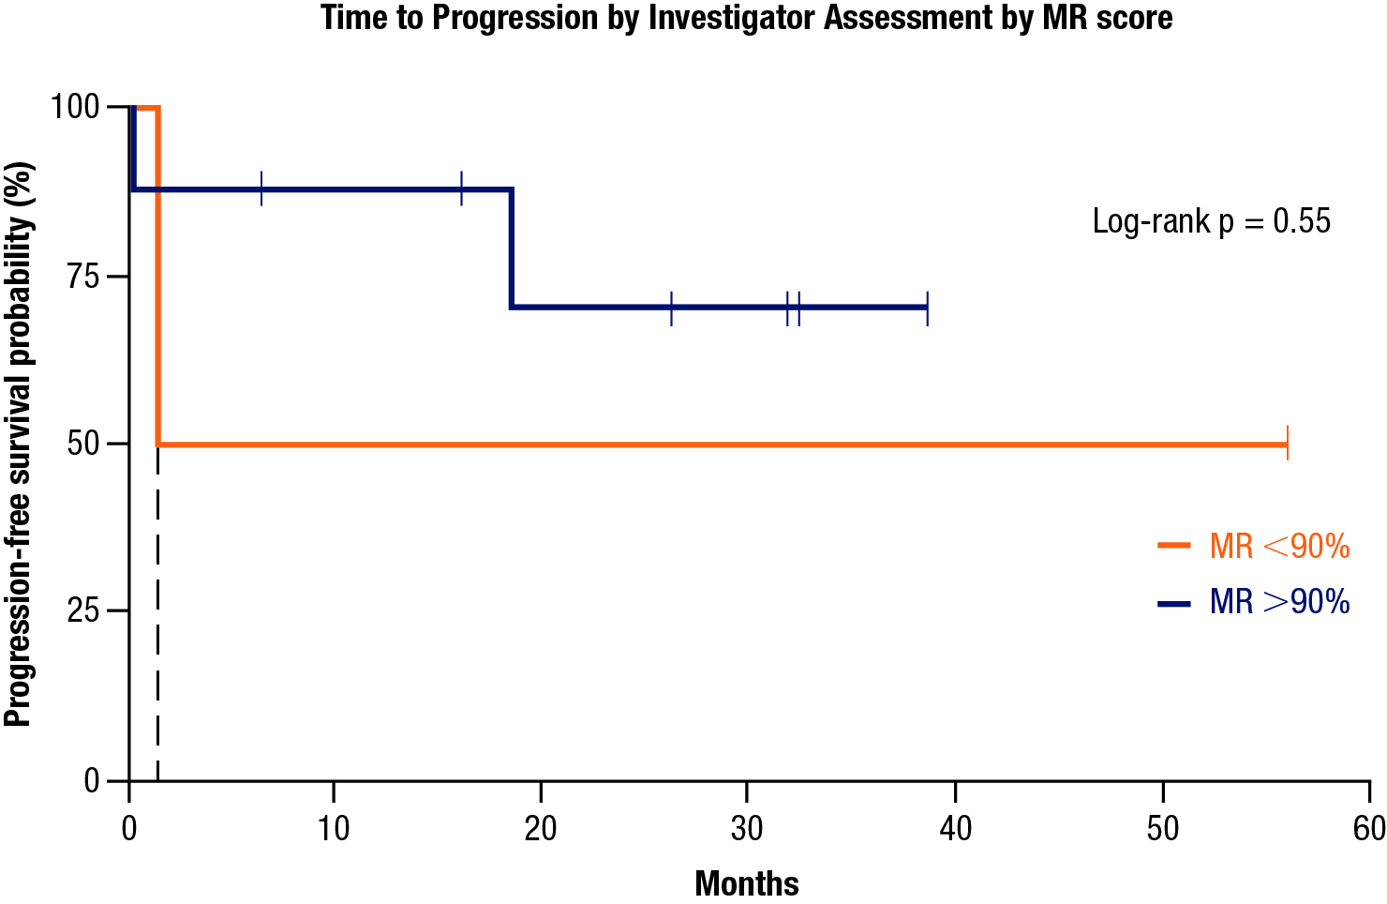

ctDNA Levels and Molecular Response
19 patients had samples with detectable ctDNA, of whom 18 had ERBB2 amplification (95% concordance between
ctDNA-based NGS and tissue-based FISH testing)
TP53, ERBB2, and EGFR were the most altered genes
Five patients with a CR or PR had activating ERBB2 mutations
Patients with PD and HER2 IHC 1+ or 2+ tumors showed
co-alterations in ERBB2, EGFR, KRAS/NRAS, BRAF, or mTOR
>90% decreases in ctDNA and MR score were observed in 8/10 (80%) of evaluable samples collected on day 15 of cycle 2
ERBB2
EGFR
MET
KRAS
NRAS
PDGFRA
KIT
BRAF
FGFR2
PIK3CA
mTOR
MYC
APC
CTNNB1
Progression-free survival by MR score
Proportion of samples with molecular alterations by gene (%)
TP53
CCNE1
ATM
CDKN2A
SMAD4
CCND1
CDK4
RB1
BRCA2
FGFR1
ARID1A
CDK6
AR
RHOA
NOTCH1
ESR1
CNV, copy number variation; INDEL, insertion-deletion; MR, molecular response; NE, not evaluable;
SNV, single nucleotide variant; VAF, variant allele frequency.
Elena Elimova, MD, MSc
Notes:
8 patients had greater than 90% ctDNA decreases, of them 5 had a CR or PR, 1 pt had PD, and 2 had non-CR or non-PD
2 patients had lower than 90% ctDNA decreases, of them 1 had a CR or PR and 1 had PD
4 patients had not detectable changes in ctDNA levels, of them 3 had a CR or PR and 1 had non-CR or non-PD

Slide 11
Safety Outcomes
 | All Patients (N = 46)
TRAEs (any component)ª, n (%) | Any grade | Grade 3 or 4
Any | 46 (100) | 30 (65)
Serious | 8 (17) | 8 (17)
Most Common^{b}
Diarrhea | 43 (93) | 18 (39)
Nausea | 37 (80) | 3 (7)
Peripheral sensory neuropathy | 30 (65) | 0
Fatigue | 24 (52) | 2 (4)
Decreased appetite | 21 (46) | 0
Vomiting | 16 (35) | 4 (9)
Hypokalemia | 14 (30) | 10 (22)
Stomatitis | 13 (28) | 0
Anemia | 12 (26) | 1 (2)
Dysgeusia | 11 (24) | 0
Decreased neutrophil count | 10 (22) | 2 (4)
Hypomagnesaemia | 10 (22) | 1 (2)
PPE syndrome | 10 (22) | 1 (2)
IRRs | 10 (22) | 0
There were no treatment-related deaths
AESIs:
  IRRs (10 [22%])
  Non-infectious pulmonary toxicities (1 [2%])
  No left ventricular dysfunction or grade ≥2 heart failure
After the first 25 patients were enrolled, protocol was amended to omit 5-FU bolus (mFOLFOX6) and to introduce mandatory antidiarrheal prophylaxis (all patients)
Loperamide 4 mg twice daily starting on the first treatment day of cycle 1 and continuing for at least 7 days
After introduction of mandatory antidiarrheal prophylaxis, patients had:
Lower incidence of any-cause grade 3 diarrhea
(56% before vs 24% after)
No discontinuations due to diarrhea
(2 patients before vs 0 patients after)
ªTRAEs could be related to zanidatamab and/or chemotherapy; ^{b}Any-grade TRAEs occurred in ≥20% of all patients.
AESI, adverse event of special interest; IRR, infusion-related reactions; PPE, palmar-plantar erythrodysesthesia; TRAE, treatment-related adverse event.
Elena Elimova, MD, MSc

Slide 12
Conclusions
In this phase 2 trial, 1L zanidatamab + chemotherapy showed clinically meaningful antitumor activity and promising survival outcomes for HER2-positive advanced GEA, especially in patients with centrally confirmed HER2-positive tumors
  For all treated patients, 1L zanidatamab + chemotherapy was associated with a cORR of 76% (primary endpoint), median DOR of 18.7 months, median PFS of 12.5 months,
  and median OS of 36.5 months
Translational data showed high ERBB2 amplification concordance between ctDNA-based NGS and tissue-based FISH testing, and suggest that 1L zanidatamab + chemotherapy could markedly reduce total ctDNA levels early in treatment
The safety profile of zanidatamab + chemotherapy was generally manageable with antidiarrheal prophylaxis, along with no treatment-related deaths and a low rate of treatment-related discontinuations
  Use of antidiarrheal prophylaxis was associated with a marked reduction in grade 3 diarrhea
Clinical development of zanidatamab + chemotherapy ± immunotherapy is ongoing with the global, randomized, phase 3 trial (HERIZON-GEA-01)
1L, first-line; cORR, confirmed objective response rate; ctDNA, circulating tumor DNA; DOR, duration of response; FISH, fluorescence in situ hybridization; GEA, gastroesophageal adenocarcinoma; HER2, human epidermal growth factor receptor 2;
NGS, next-generation sequencing; ORR, objective response rate; OS, overall survival; PFS, progression-free survival.
Elena Elimova, MD, MSc

Slide 13
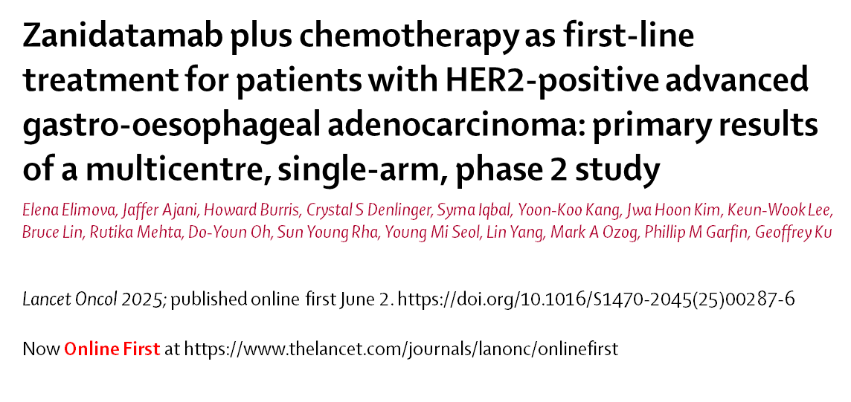

Acknowledgments
The authors would like to thank all the patients and their families, as well as all the investigators, clinical trial researchers, personnel and staff who contributed to or participated in the trial
Now published in The Lancet Oncology
Elena Elimova, MD, MSc

Slide 14
Lay Summary Slide
What did this research tell us?
    This global, phase 2 trial assessed the safety and tumor shrinking ability of zanidatamab (a medicine that binds to the HER2 protein on cancer cells) in combination with chemotherapy for patients with HER2-expressing gastroesophageal cancer whose disease had spread to other parts of the body
  Many patients treated with zanidatamab plus chemotherapy had their tumors shrink or disappear within 2 months since their treatment started
  Some patients receiving zanidatamab were able to live >3 years after the diagnosis of metastatic or unresectable gastroesophageal cancer
  Side effects of treatment with zanidatamab plus chemotherapy were generally tolerated and could be managed with proper care
Who does this research impact?
Patients whose gastroesophageal cancer has spread to other parts of the body
What does this mean for patients right now?
Zanidatamab may represent a promising HER2-targeted therapy option for patients with HER2-positive gastroesophageal cancer that has spread beyond the primary tumor site
Elena Elimova, MD, MSc

