Slide 1
Lurbinectedin + atezolizumab as first-line maintenance treatment in patients with extensive-stage small cell lung cancer:
Primary results of the Phase 3 IMforte trial
Luis Paz-Ares,¹ Hossein Borghaei,² Stephen V. Liu,³ Solange Peters,⁴ Roy S. Herbst,⁵ Katarzyna Stencel,⁶
Margarita Majem,⁷ Grzegorz Czyżewicz,⁸ Reyes Bernabé Caro,⁹ Ki Hyeong Lee,¹⁰ Melissa L. Johnson,¹¹ Nuri Karadurmuş,¹² Christian Grohé,¹³ Vaikunth Cuchelkar,¹⁴ Vilma Graupner,¹⁵ Monika Kaul,¹⁴ Ya-Chen Lin,¹⁴ Debasis Chakrabarti,¹⁶
Kamalnayan Bhatt,¹⁶ Martin Reck¹⁷
¹Hospital Universitario 12 de Octubre, H12O-CNIO Lung Cancer Unit, Universidad Complutense and Ciberonc, Madrid, Spain; ²Fox Chase Cancer Center, Philadelphia, PA, USA; ³Lombardi Comprehensive Cancer Center, Georgetown University, Washington, DC, USA; ⁴University Hospital CHUV, Lausanne, Switzerland; ⁵Yale School of Medicine, New Haven,
CT, USA; ⁶Wielkopolska Center of Pulmonology and Thoracic Surgery of Eugenia and Janusz Zeyland, Poznan, Poland; ⁷Hospital de la Santa Creu i Sant Pau, Barcelona, Spain;
⁸The John Paul II Specialist Hospital, Kraków, Poland; ⁹Hospital Universitario Virgen del Rocío, Seville, Spain; ¹⁰Chungbuk National University Hospital, Cheongju, South Korea; ¹¹Tennessee Oncology, Sarah Cannon Research Institute, Nashville, TN, USA; ¹²University of Health Sciences, Gülhane Training and Research Hospital, Ankara, Türkiye;
¹³Klinik für Pneumologie, Evangelische Lungenklinik Berlin, Berlin, Germany; ¹⁴Genentech Inc, South San Francisco, CA, USA; ¹⁵F. Hoffmann-La Roche Ltd, Basel, Switzerland;
¹⁶Jazz Pharmaceuticals plc, Dublin, Ireland; ¹⁷Lung Clinic Grosshansdorf, Airway Research Center North, German Center of Lung Research, Grosshansdorf, Germany
Luis Paz-Ares, MD, PhD
IMforte ASCO 2025 Abstract 8006

Slide 2
Key takeaway points
IMforte demonstrated a statistically significant and clinically meaningful improvement in PFS and OS with 1L maintenance treatment with lurbinectedin + atezolizumab vs atezolizumab in
patients with ES-SCLC
The safety profile of the combination was predictable with an increased incidence of AEs, most of which were low grade; treatment discontinuation rates were low
The combination of lurbinectedin + atezolizumab has the potential to become the new standard
of care for 1L maintenance treatment of ES-SCLC
Luis Paz-Ares, MD, PhD
IMforte ASCO 2025 Abstract 8006

Slide 3
Background
Despite improved efficacy with 1L immune checkpoint inhibitors (ICIs) + platinum-based chemotherapy, most patients with ES-SCLC eventually experience disease progression and long-term survival remains limited¹⁻⁵
Due to the high attrition rate in ES-SCLC of ~60%⁶, offering the most effective treatment in the front-line setting before progression is crucial to improve outcomes in this difficult-to-treat disease
Lurbinectedin is an alkylating agent and transcription inhibitor that is approved in the US and other countries for the treatment of patients with metastatic SCLC who experienced disease progression on or after platinum-based chemotherapy
In pre-clinical studies, lurbinectedin was shown to synergize with ICIs^{7,8} to achieve high rates of tumor regression
and induce long-term T-cell memory^{9,10}
In Phase 1/2 trials in patients with relapsed ES-SCLC, the combination of lurbinectedin and ICIs was well tolerated with promising activity¹¹⁻¹³
The global, open-label, randomized, Phase 3 IMforte study investigated the efficacy and safety of
lurbinectedin + atezolizumab versus atezolizumab for the maintenance treatment of ES-SCLC in patients
whose disease had not progressed after 1L induction treatment with atezolizumab + carboplatin + etoposide
1L, first line; ES-SCLC, extensive-stage small cell lung cancer; OS, overall survival; PFS, progression-free survival; SCLC, small cell lung cancer.
1. Liu SV, et al. J Clin Oncol 2021;39:619-30. 2. Paz-Ares L, et al. ESMO Open 2022;7:100408. 3. Goldman JW, et al. Lancet Oncol 2021;22:51-65. 4. Reck M, et al. Lung Cancer 2024;196:107924.
5. Cheng Y, et al. JAMA 2022;328:1223-32. 6. Ramirez RA, et al. ASCO 2022 [abstract 8584]. 7. Xie W, et al. Oncoimmunology 2019;8:e1656502. 8. Chakraborty S, et al. Cell Rep Med 2024;5:101852.
9. Russo-Cabrera JS, et al. Ann Oncol 2023;34:S636. 10. Russo-Cabrera JS, et al. AACR 2025 [abstract 5837]. 11. Calles A, et al. J Thorac Oncol 2025 doi: 10.1016/j.jtho.2025.02.005.
12. Ponce Aix S, et al. J Immunother Cancer 2021;9(Suppl 2):A493. 13. Ponce Aix S, et al. ASCO 2025 [abstract 8013].
Luis Paz-Ares, MD, PhD
IMforte ASCO 2025 Abstract 8006

Slide 4
IMforte study design
4
First screening
Induction phase
Second screening
Maintenance phase
Eligibility criteria
No prior systemic treatment for
ES-SCLC
No CNS metastases
ECOG PS 0/1
N=660
Eligibility criteria
Ongoing CR/PR or SD following induction therapy
ECOG PS 0/1
N=483^{b}
Lurbi (3.2 mg/m²) +
atezo (1200 mg)
IV q3w^{c}
Treat until PD or unacceptable toxicity
No crossover allowed
ENR
Atezo +
carbo + etop
(4 cycles q3w)ª
R
1:1
Follow-up
Atezo (1200 mg)
IV q3w
Efficacy endpoint assessments started from randomization into the maintenance phase; safety analyses were from MC1D1
Stratification factors for randomization
ECOG PS (0/1)
LDH (≤ULN/>ULN)
Presence of liver metastases (Y/N) at induction BL
Prior receipt of PCI (Y/N)
Primary endpoints
IRF-PFS and OS
Secondary endpoints included
INV-PFS, ORR, DOR, and safety
Last patient randomized: April 30, 2024
Clinical cutoff: July 29, 2024
ClinicalTrials.gov ID: NCT05091567.
ª Administered per standard dose. ^{b} 73% of patients continued from induction to maintenance. ^{c} With prophylactic granulocyte colony-stimulating factor and anti-emetics.
atezo, atezolizumab; BL, baseline; carbo, carboplatin; CNS, central nervous system; ECOG PS, Eastern Cooperative Oncology Group performance status; ENR, enrollment; etop, etoposide;
INV-PFS, investigator-assessed PFS; IRF-PFS, independent review facility-assessed PFS; IV, intravenously; LDH, lactate dehydrogenase; lurbi, lurbinectedin; MC1D1, maintenance Cycle 1 Day 1;
PCI, prophylactic cranial irradiation; q3w, every 3 weeks; R, randomization; ULN, upper limit of normal; Y/N, yes/no.
Luis Paz-Ares, MD, PhD
IMforte ASCO 2025 Abstract 8006

Slide 5
IMforte study design
5
First screening
Induction phase
Second screening
Maintenance phase
Eligibility criteria
No prior systemic treatment for
ES-SCLC
No CNS metastases
ECOG PS 0/1
N=660
Eligibility criteria
Ongoing CR/PR or SD following induction therapy
ECOG PS 0/1
N=483^{b}
Lurbi (3.2 mg/m²) +
atezo (1200 mg)
IV q3w^{c}
Treat until PD or unacceptable toxicity
No crossover allowed
ENR
Atezo +
carbo + etop
(4 cycles q3w)ª
R
1:1
Follow-up
Atezo (1200 mg)
IV q3w
Efficacy endpoint assessments started from randomization into the maintenance phase; safety analyses were from MC1D1
Stratification factors for randomization
ECOG PS (0/1)
LDH (≤ULN/>ULN)
Presence of liver metastases (Y/N) at induction BL
Prior receipt of PCI (Y/N)
Primary endpoints
IRF-PFS and OS
Secondary endpoints included
INV-PFS, ORR, DOR, and safety
Last patient randomized: April 30, 2024
Clinical cutoff: July 29, 2024
ClinicalTrials.gov ID: NCT05091567.
ª Administered per standard dose. ^{b} 73% of patients continued from induction to maintenance. ^{c} With prophylactic granulocyte colony-stimulating factor and anti-emetics.
atezo, atezolizumab; BL, baseline; carbo, carboplatin; CNS, central nervous system; ECOG PS, Eastern Cooperative Oncology Group performance status; ENR, enrollment; etop, etoposide;
INV-PFS, investigator-assessed PFS; IRF-PFS, independent review facility-assessed PFS; IV, intravenously; LDH, lactate dehydrogenase; lurbi, lurbinectedin; MC1D1, maintenance Cycle 1 Day 1;
PCI, prophylactic cranial irradiation; q3w, every 3 weeks; R, randomization; ULN, upper limit of normal; Y/N, yes/no.
Luis Paz-Ares, MD, PhD
IMforte ASCO 2025 Abstract 8006

Slide 6
Statistical analysis plan
OS
  Target HR of 0.71 with a power of 85%
  Interim analysis occurred when
  ~219 deaths were observed in the FASª or when the minimum follow-up^{b} was completed, whichever occurred later
  If OS results were statistically significant at the interim analysis, they would constitute the primary analysis
IRF-PFS
  No interim analysis
  Primary analysis was conducted at the time of OS interim analysis
Type 1 error rate control strategy
Lurbi + atezo
vs atezo
2-sided α=0.05
IRF-PFS
(α=0.001)
If rejected, α=0.001 will be passed to OS
OS
(α=0.049)
If rejected, α=0.049 will be passed to IRF-PFS
ª The FAS was defined as all patients randomized into the maintenance phase regardless of whether or not the assigned study treatment was received.
^{b} The minimum follow-up was defined as 5 months after the target sample size of 450 participants had been randomized.
FAS, full analysis set.
Luis Paz-Ares, MD, PhD
IMforte ASCO 2025 Abstract 8006

Slide 7
Baseline characteristics of patients randomized into the maintenance phase
Characteristic | Lurbi + atezo (n=242) | Atezo (n=241)
Age, median (range), years | 65.0 (38-85) | 67.0 (35-85)
<65 years, n (%) | 118 (48.8) | 90 (37.3)
Sex, male, n (%) | 151 (62.4) | 151 (62.7)
Race, n (%)
White | 195 (80.6) | 199 (82.6)
Asian | 31 (12.8) | 31 (12.9)
Otherª | 16 (6.6) | 11 (4.6)
Current or previous tobacco use history, n (%) | 235 (97.1) | 236 (97.9)
Liver metastases at induction BL, n (%)^{b} | 100 (41.3) | 94 (39.0)
Prior PCI, n (%)^{b} | 34 (14.0) | 37 (15.4)
ECOG PS 0 at maintenance BL, n (%)^{b} | 105 (43.4) | 102 (42.3)
LDH ≤ULN at maintenance BL, n (%)^{b} | 176 (72.7) | 179 (74.3)
Time from induction Cycle 1 Day 1 to randomization, median (range), mo | 3.2 (2.6-4.6) | 3.2 (2.7-5.2)
Response to induction therapy, n (%)^{c}
CR/PR | 206 (87.3) | 213 (88.8)
SD | 28 (11.9) | 25 (10.4)
PD^{d} | 2 (0.8) | 2 (0.8)
Clinical cutoff: July 29, 2024. ª Includes American Indian or Alaska Native and Black or African American patients, as well as patients with unreported race. ^{b} Stratification factors for randomization;
data determined from electronic case-report forms. ^{c} n=236 in the lurbi + atezo arm and n=240 in the atezo arm; 7 randomized patients did not have a maintenance screening tumor assessment.
^{d} Randomization of these patients was in violation of the protocol. BL, baseline. PCI, prophylactic cranial irradiation.
Luis Paz-Ares, MD, PhD
IMforte ASCO 2025 Abstract 8006

Slide 8
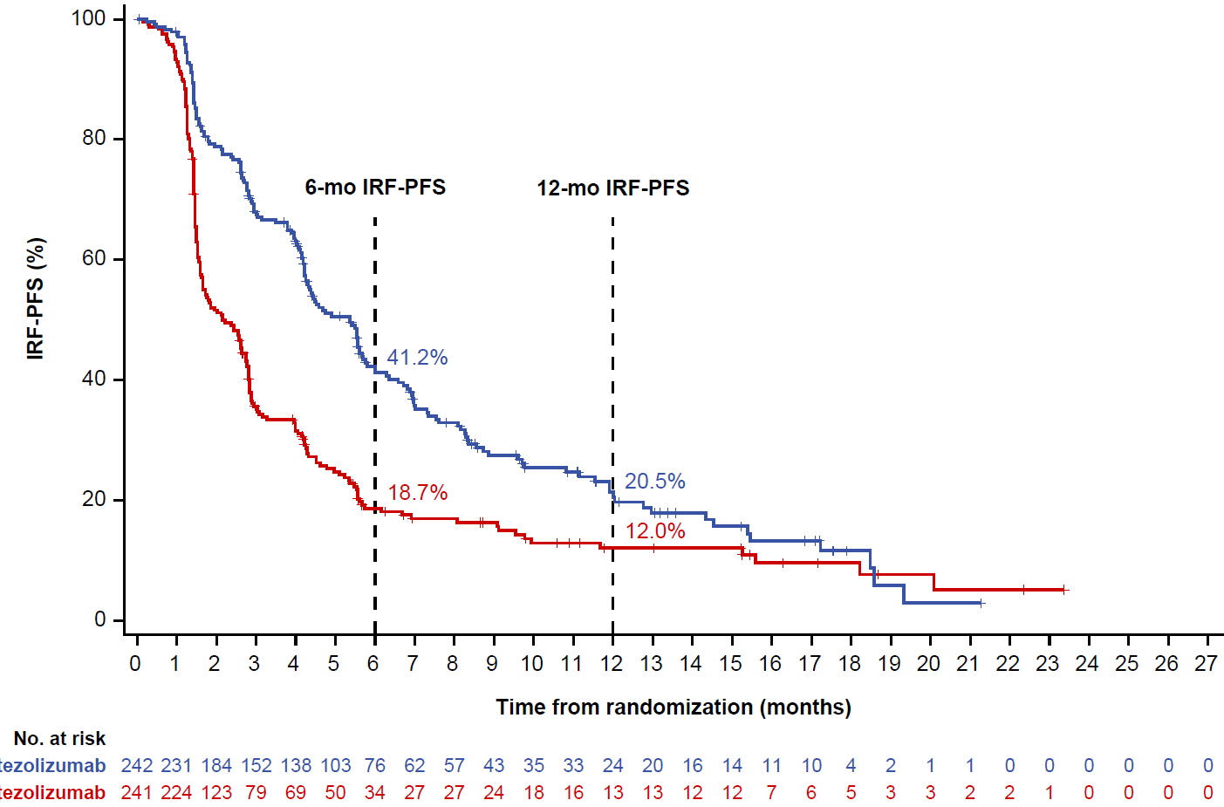
IRF-PFS from randomization into maintenance phase
R
PFS assessment started from randomization into the maintenance phase
IRF-PFS | Lurbi + atezo (n=242) | Atezo (n=241)
Events, n (%) | 174 (71.9) | 202 (83.8)
PFS, median (95% CI), mo | 5.4 (4.2, 5.8) | 2.1 (1.6, 2.7)
Stratified HR (95% CI) | 0.54 (0.43, 0.67)
Stratified P value (2-sided) | <0.0001
α boundary (2-sided) | 0.001
6-mo IRF-PFS
12-mo IRF-PFS
IRF-PFS (%)
41.2%
18.7%
20.5%
12.0%
Time from randomization (months)
No. at risk
Lurbi + atezo
Atezo
Clinical cutoff: July 29, 2024; median survival follow-up: 15.0 mo (minimum follow-up: 3.0 mo).
CI, confidence interval; HR, hazard ratio.
Luis Paz-Ares, MD, PhD
IMforte ASCO 2025 Abstract 8006

Slide 9
IRF-PFS from randomization into maintenance phase
R
PFS assessment started from randomization into the maintenance phase
IRF-PFS | Lurbi + atezo (n=242) | Atezo (n=241)
Events, n (%) | 174 (71.9) | 202 (83.8)
PFS, median (95% CI), mo | 5.4 (4.2, 5.8) | 2.1 (1.6, 2.7)
Stratified HR (95% CI) | 0.54 (0.43, 0.67)
Stratified P value (2-sided) | <0.0001
α boundary (2-sided) | 0.001
6-mo IRF-PFS
12-mo IRF-PFS
IRF-PFS (%)
Investigator-assessed PFS was consistent with IRF-PFS
Median: 5.4 mo with lurbi + atezo and 2.7 mo with atezo (stratified HR, 0.55 [95% CI: 0.45, 0.68])
41.2%
18.7%
20.5%
12.0%
Time from randomization (months)
No. at risk
Lurbi + atezo
Atezo
Clinical cutoff: July 29, 2024; median survival follow-up: 15.0 mo (minimum follow-up: 3.0 mo).
CI, confidence interval; HR, hazard ratio.
Luis Paz-Ares, MD, PhD
IMforte ASCO 2025 Abstract 8006

Slide 10
IRF-PFS subgroup analysis
Baseline risk factors |  | Events/patients, n/N |  |  | Unstratified IRF-PFS HR (95% CI)
 |  | Lurbi + atezo | Atezo
All patients |  | 174/242 | 202/241 |  | 0.56 (0.46, 0.69)
Age, years | <65 | 86/118 | 73/90 |  | 0.64 (0.46, 0.87)
 | ≥65 | 88/124 | 129/151 |  | 0.51 (0.38, 0.67)
Sex | Male | 110/151 | 131/151 |  | 0.49 (0.38, 0.64)
 | Female | 64/91 | 71/90 |  | 0.69 (0.49, 0.98)
Raceª | White | 140/195 | 167/199 |  | 0.58 (0.46, 0.73)
 | Asian | 22/31 | 26/31 |  | 0.48 (0.27, 0.86)
Tobacco use historyª | Current | 61/88 | 57/73 |  | 0.65 (0.45, 0.95)
 | Previous | 107/147 | 141/163 |  | 0.53 (0.41, 0.68)
Liver metastases at induction BL^{b} | Yes | 75/100 | 87/94 |  | 0.45 (0.33, 0.62)
 | No | 99/142 | 115/147 |  | 0.62 (0.48, 0.82)
Prior PCI^{b} | Yes | 25/34 | 29/37 |  | 0.76 (0.44, 1.31)
 | No | 149/208 | 173/204 |  | 0.53 (0.42, 0.66)
ECOG PS^{b} | 0 | 76/105 | 82/102 |  | 0.58 (0.42, 0.80)
 | 1 | 98/137 | 120/139 |  | 0.56 (0.43, 0.73)
LDH^{b} | ≤ULN | 123/176 | 150/179 |  | 0.53 (0.41, 0.67)
 | >ULN | 51/66 | 52/62 |  | 0.65 (0.44, 0.96)
Response to induction therapy^{a,c} | CR/PR | 143/206 | 176/213 |  | 0.53 (0.42, 0.67)
 | SD | 26/28 | 23/25 |  | 0.72 (0.40, 1.29)
Favors lurbi + atezo
Favors atezo
4
Clinical cutoff: July 29, 2024; median survival follow-up: 15.0 mo (minimum follow-up: 3.0 mo).
ª Data from subgroups with small numbers are not displayed. ^{b} Stratification factor for randomization; data determined from electronic case-report forms. ^{c} n=236 in the lurbi + atezo arm and n=240 in the atezo arm; 7 randomized patients did not have a maintenance screening tumor assessment.
Luis Paz-Ares, MD, PhD
IMforte ASCO 2025 Abstract 8006

Slide 11
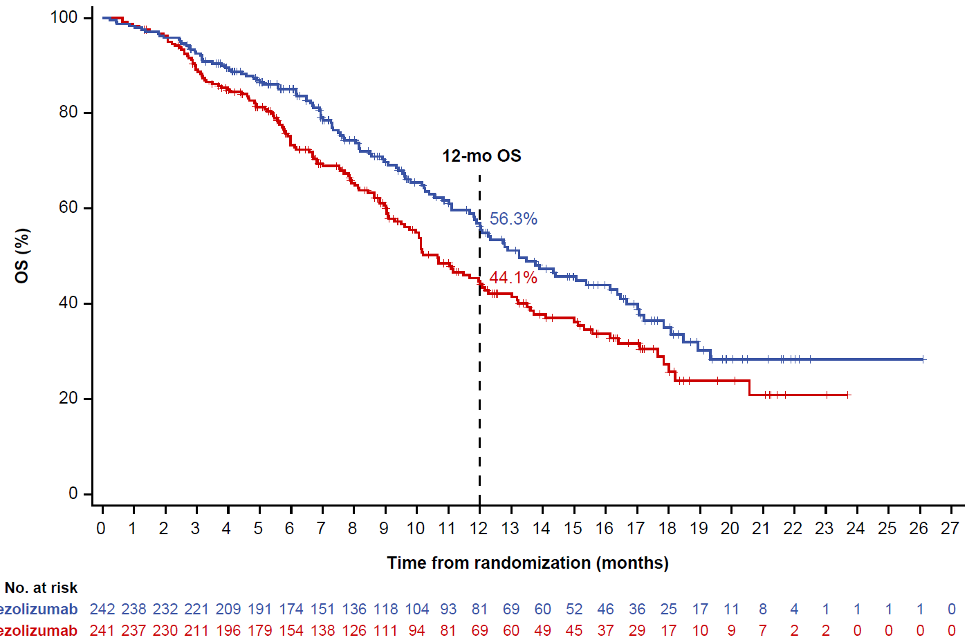
OS from randomization into maintenance phase
R
OS assessment started from randomization into the maintenance phase (median time from induction C1D1 to randomization: 3.2 months in each arm)
OS | Lurbi + atezo (n=242) | Atezo (n=241)
Events, n (%) | 113 (46.7) | 136 (56.4)
OS, median (95% CI), mo | 13.2 (11.9, 16.4) | 10.6 (9.5, 12.2)
Stratified HR (95% CI) | 0.73 (0.57, 0.95)
Stratified P value (2-sided) | 0.0174
α boundary (2-sided)ª | 0.0313
12-mo OS
56.3%
OS (%)
44.1%
Time from randomization (months)
No. at risk
Lurbi + atezo
Atezo
Clinical cutoff: July 29, 2024; median survival follow-up: 15.0 mo (minimum follow-up: 3.0 mo).
ª As determined by the Hwang-Shih-Decani alpha spending function with the gamma parameter of −1.5.
Luis Paz-Ares, MD, PhD
IMforte ASCO 2025 Abstract 8006

Slide 12
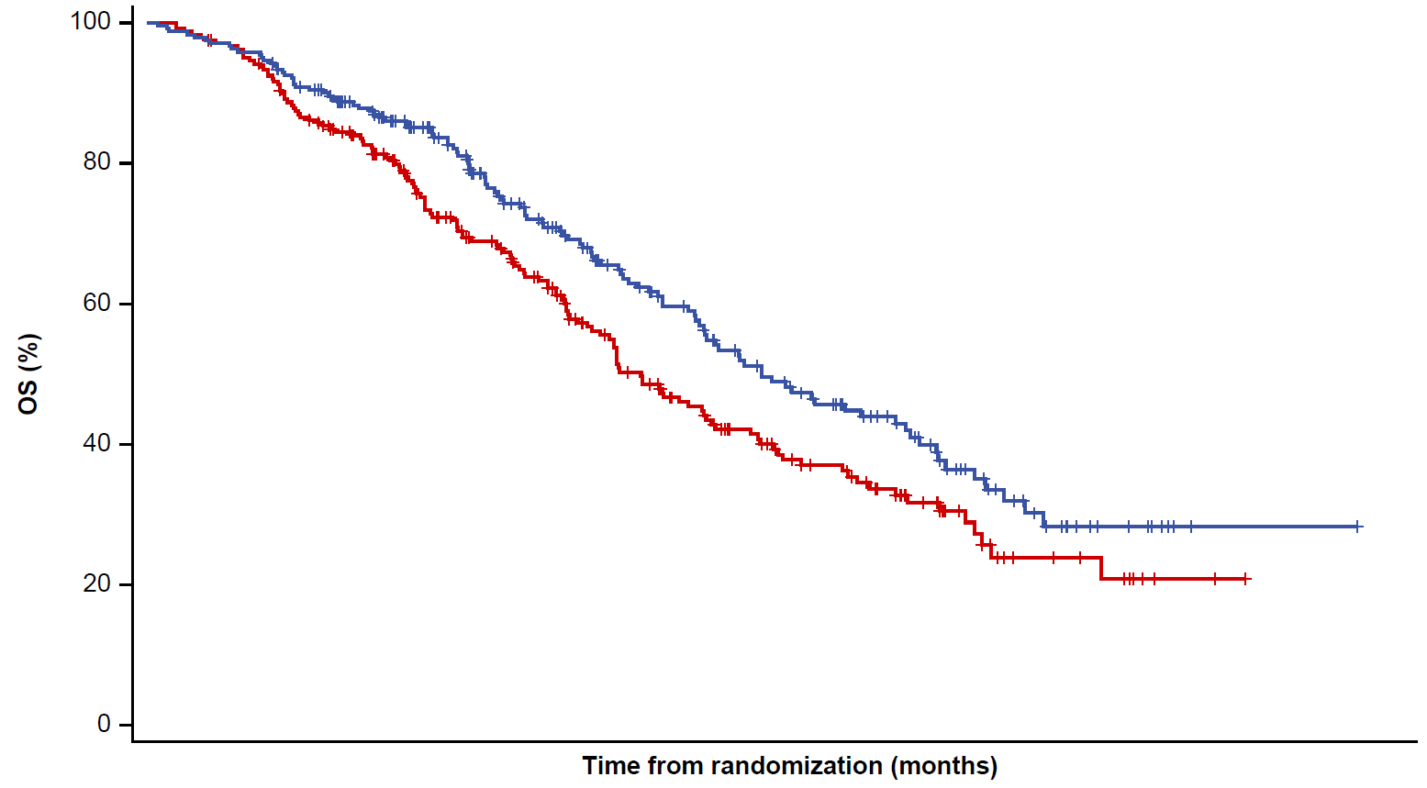
OS from randomization into maintenance phase
OS | Lurbi + atezo (n=242) | Atezo (n=241)
Events, n (%) | 113 (46.7) | 136 (56.4)
OS, median (95% CI), mo | 13.2 (11.9, 16.4) | 10.6 (9.5, 12.2)
Stratified HR (95% CI) | 0.73 (0.57, 0.95)
Stratified P value (2-sided) | 0.0174
α boundary (2-sided)ª | 0.0313
OS (%)
Time from randomization (months)
Maintenance treatment
Lurbi + atezo
Median OS from randomization: 13.2 months
Induction treatment
Atezo + carbo + etop
3.2 monthsª
IMforte results do not include time on induction treatment
R
Maintenance treatment
Atezo
Median OS from randomization: 10.6 months
ª Median time from start of induction treatment to randomization was analyzed for 483 randomized patients. Note: 660 patients were enrolled into the induction phase, out of whom 177 patients were not randomized into the maintenance phase.
Luis Paz-Ares, MD, PhD
IMforte ASCO 2025 Abstract 8006

Slide 13
OS subgroup analysis
Baseline risk factors |  | Events/patients, n/N |  |  | Unstratified OS HR (95% CI)
 |  | Lurbi + atezo | Atezo
All patients |  | 113/242 | 136/241 |  | 0.74 (0.58, 0.96)
Age, years | <65 | 53/118 | 49/90 |  | 0.77 (0.52, 1.14)
 | ≥65 | 60/124 | 87/151 |  | 0.76 (0.55, 1.05)
Sex | Male | 75/151 | 88/151 |  | 0.72 (0.53, 0.98)
 | Female | 38/91 | 48/90 |  | 0.78 (0.51, 1.19)
Raceª | White | 92/195 | 118/199 |  | 0.71 (0.54, 0.94)
 | Asian | 13/31 | 14/31 |  | 0.86 (0.40, 1.84)
Tobacco use historyª | Current | 38/88 | 39/73 |  | 0.79 (0.51, 1.24)
 | Previous | 72/147 | 94/163 |  | 0.76 (0.56, 1.03)
Liver metastases at induction BL^{b} | Yes | 55/100 | 63/94 |  | 0.70 (0.48, 1.00)
 | No | 58/142 | 73/147 |  | 0.76 (0.54, 1.07)
Prior PCI^{b} | Yes | 16/34 | 18/37 |  | 1.02 (0.52, 2.00)
 | No | 97/208 | 118/204 |  | 0.70 (0.53, 0.92)
ECOG PS^{b} | 0 | 51/105 | 53/102 |  | 0.88 (0.60, 1.29)
 | 1 | 62/137 | 83/139 |  | 0.66 (0.47, 0.92)
LDH^{b} | ≤ULN | 72/176 | 97/179 |  | 0.66 (0.49, 0.90)
 | >ULN | 41/66 | 39/62 |  | 0.96 (0.62, 1.50)
Response to induction therapy^{a,c} | CR/PR | 92/206 | 115/213 |  | 0.76 (0.57, 0.99)
 | SD | 17/28 | 18/25 |  | 0.62 (0.31, 1.24)
Favors lurbi + atezo
Favors atezo
4
Clinical cutoff: July 29, 2024; median survival follow-up: 15.0 mo (minimum follow-up: 3.0 mo).
ª Data from subgroups with small numbers are not displayed. ^{b} Stratification factor for randomization; data determined from electronic case-report forms. ^{c} n=236 in the lurbi + atezo arm and n=240 in the atezo arm; 7 randomized patients did not have a maintenance screening tumor assessment.
Luis Paz-Ares, MD, PhD
IMforte ASCO 2025 Abstract 8006

Slide 14
Confirmed IRF-assessed ORR and DOR during the maintenance phase
Background: At the time of randomization, 88% of patients had CR/PR and 11% had SD to induction therapy
  Tumor response in the maintenance phase was assessed against maintenance baseline
Patients with measurable diseaseª | Lurbi + atezo (n=175) | Atezo (n=182)
Confirmed objective response, n (%) (95% CI)^{b} | 34 (19.4) (13.9, 26.1) | 19 (10.4) (6.4, 15.8)
Difference in ORR (95% CI), % | 9.0 (1.1, 16.9)
CR, n (%) | 4 (2.3) | 1 (0.5)
PR, n (%) | 30 (17.1) | 18 (9.9)
SD, n (%) | 96 (54.9) | 68 (37.4)
PD, n (%) | 34 (19.4) | 87 (47.8)
Missing or non-evaluable, n (%) | 11 (6.3) | 8 (4.4)
DOR^{c}
Responders with an event/responders, n (%) | 14/34 (41.2) | 11/19 (57.9)
Median DOR (95% CI), mo | 9.0 (5.5, NE) | 5.6 (4.2, NE)
Clinical cutoff: July 29, 2024. ª Measurable disease was not an inclusion criterion to enter the maintenance phase. ^{b} The confirmed ORR was defined as the proportion of randomized patients with a CR or PR on two consecutive occasions ≥4 weeks apart after randomization and was assessed in patients who had measurable disease at maintenance baseline. ^{c} DOR was assessed in patients who had a confirmed objective response in the maintenance phase. NE, not estimable.
Luis Paz-Ares, MD, PhD
IMforte ASCO 2025 Abstract 8006

Slide 15
Follow-up systemic anticancer treatments
Patients, n (%) | Lurbi + atezo (n=242) | Atezo (n=241)
Patients who discontinued maintenance treatment | 197 | 208
Patients with ≥1 follow-up systemic anticancer treatment | 108 (44.6) | 132 (54.8)
Chemotherapy | 89 (36.8) | 119 (49.4)
Immunotherapy | 25 (10.3) | 20 (8.3)
Targeted therapy | 3 (1.2) | 2 (0.8)
Other | 3 (1.2) | 3 (1.2)
At the time of clinical cutoff, no patient in the lurbi + atezo arm and
22 patients (9.1%) in the atezo arm had received follow-up lurbi treatment
Clinical cutoff: July 29, 2024.
Luis Paz-Ares, MD, PhD
IMforte ASCO 2025 Abstract 8006

Slide 16
Safety summary during the maintenance phase
Patients with ≥1 AE, n (%) | Lurbi + atezo (n=242) | Atezo (n=240)
All-cause AEs | 235 (97.1) | 194 (80.8)
Grade 3/4 AEs | 92 (38.0) | 53 (22.1)
Treatment-related Grade 3/4 AEs | 62 (25.6) | 14.0 (5.8)
Grade 5 AEs | 12 (5.0) | 6 (2.5)
Treatment-related Grade 5 AEs | 2 (0.8)ª | 1 (0.4)^{b}
Serious AEs | 75 (31.0) | 41 (17.1)
AEs leading to discontinuation of any study drug | 15 (6.2) | 8 (3.3)
AEs leading to dose interruption/ modification of any study drug^{c} | 92 (38.0) | 33 (13.8)
Patients with ≥1 AE, n (%) | Lurbi + atezo (n=242) | Atezo (n=240)
Lurbinectedin AESI^{d} | 93 (38.4) | 62 (25.8)
Grade 5 AESI | 7 (2.9) | 4 (1.7)
Atezolizumab AESI^{d} | 76 (31.4) | 54 (22.5)
Grade 5 AESI | 0 | 0
Atezolizumab AESI requiring corticosteroids | 40 (16.5) | 18 (7.5)
Median treatment duration, mo | 4.1 (lurbi)/ 4.2 (atezo) | 2.1
Median number of doses received | 6.5 (lurbi)/ 7.0 (atezo) | 4.0
Clinical cutoff: July 29, 2024. One patient randomized to the atezo arm did not receive treatment and was not included in the safety analysis set.
ª Sepsis and febrile neutropenia, both considered related to lurbi. ^{b} Sepsis considered related to atezo. ^{c} Atezo dose modifications were not permitted. ^{d} AESI for lurbi and atezo were pre-specified based on their mechanism of action and were independent of the causal relationship assigned by the investigator. AE, adverse event; AESI, adverse events of special interest.
Luis Paz-Ares, MD, PhD
IMforte ASCO 2025 Abstract 8006

Slide 17
All-cause AEs with incidence ≥10% in either arm
Lurbi + atezo
Atezo
Any AE
97.1%
80.8%
Nausea
36.4%
4.2%
Anemia
31.8%
6.7%
Fatigue
20.2%
7.9%
Decreased appetite
16.9%
6.7%
Platelet count decreased
15.3%
2.9%
Febrile neutropenia
Lurbi + atezo: 1.7%ª
Atezo: 0%
Grade 3/4 infections and infestations^{b}
Lurbi + atezo: 6.6%
Atezo: 5.0%
Diarrhea
14.0%
7.5%
Vomiting
13.6%
2.5%
Asthenia
12.8%
6.3%
Thrombocytopenia
12.8%
1.7%
Neutrophil count decreased
12.8%
1.3%
Grade 1/2
Grade 3/4
Constipation
12.0%
6.3%
Neutropenia
10.7%
1.7%
Patients (%)
Clinical cutoff: July 29, 2024. Percentage labels represent all-grade AEs, including Grade 5 AEs. Grade 5 AEs occurred in 12 (5.0%) patients in the lurbi + atezo arm and 6 (2.5%) patients in the atezo arm.
ª Includes 1 Grade 5 AE. ^{b} Grade 5 infections: lurbi + atezo arm (n=6 [2.5%]): COVID-19 pneumonia, pneumonia, pneumonia viral, sepsis, septic shock, and vascular device infection (n=1 each);
atezo arm (n=4 [1.7%]): pneumonia (n=2), abscess intestinal, and sepsis (n=1 each).
Luis Paz-Ares, MD, PhD
IMforte ASCO 2025 Abstract 8006

Slide 18
Conclusions
IMforte demonstrated a statistically significant and clinically meaningful improvement in IRF-PFS and OS with
1L maintenance treatment with lurbinectedin + atezolizumab vs atezolizumab in patients with ES-SCLC
  Stratified IRF-PFS HR: 0.54 (95% CI: 0.43, 0.67); P<0.0001
  Stratified OS HR: 0.73 (95% CI: 0.57, 0.95); P=0.0174
IRF-PFS and OS benefit with lurbinectedin + atezolizumab was generally consistent across the majority
of subgroups
Despite the higher rate of Grade 3/4 AEs and SAEs, there were no new or unexpected safety signals
with lurbinectedin + atezolizumab
  The safety profile was predictable, with mostly low-grade AEs and low treatment discontinuation rates
  There was no clinically meaningful increase in immune-related AEs
IMforte is the first Phase 3 study to show PFS and OS improvement with 1L maintenance treatment
for ES-SCLC, highlighting the potential of lurbinectedin + atezolizumab to become a new standard of care
for 1L maintenance therapy in patients with this aggressive and difficult-to-treat disease
Luis Paz-Ares, MD, PhD
IMforte ASCO 2025 Abstract 8006

Slide 19
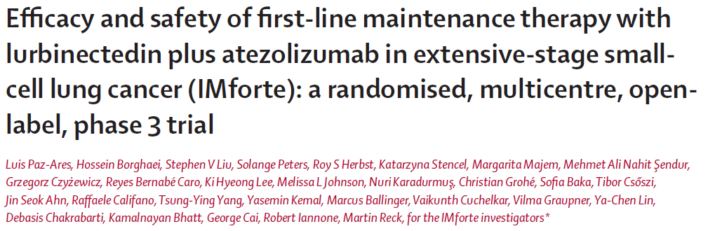

Now published in The Lancet
https://doi.org/10.1016/S0140-6736(25)01011-6
Published Online First at https://www.thelancet.com/journals/lancet/onlinefirst
Luis Paz-Ares, MD, PhD
IMforte ASCO 2025 Abstract 8006

Slide 20

Acknowledgments
The patients and their families
The investigators and staff at all clinical study sites
This study was sponsored by F. Hoffmann-La Roche Ltd.
The study was co-funded by Jazz Pharmaceuticals
Medical writing assistance was provided by Bena Lim, PhD, CMPP, of Nucleus Global, an Inizio Company,
and funded by F. Hoffmann-La Roche Ltd
Investigators and study sites
Belgium
Charlotte Van De Kerkhove
Els Wauters
Kristof Cuppens
Marc Lambrechts
Mariana Brandao
Sebahat Ocak
Germany
Achim Rittmeyer
Christian Grohé
Daniel Misch
Ekkehard Eigendorff
Martin Reck
Niels Reinmuth
Petra Hoffknecht
Sabine Bohnet
Sebastian Ertl
Stefan Hammerschmidt
Wolfgang Schütte
Greece
Athanasios Kotsakis
George Fountzilas
Giannis Mountzios
Konstantinos Syrigos
Sofia Baka
Hungary
Arpad Boronkai
Gabriella Galffy
Gabriella Temesi
Tibor Csoszi
Italy
Diego Signorelli
Filippo De Marinis
Manolo D'arcangelo
Paola Taveggia
Roberto Ferrara
Rossana Berardi
Mexico
Jorge Arturo Alatorre Alexander
Jorge Luis Martinez Rodriguez
Juan Vazquez Limon
Poland
Adam Pluzanski
Aleksandra Szczesna
Andrzej Badzio
Andrzej Kazarnowicz
Grzegorz Czyzewicz
Katarzyna Stencel
Republic of Korea
Gyeong-Won Lee
Jin-Seok Ahn
Jun Ho Ji
Ki Hyeong Lee
Sang-We Kim
Se Hyun Kim
Shin Yup Lee
Young Joo Min
Spain
Edurne Arriola Aperribay
Jose Carlos Benitez Montañez
Luis Paz-Ares Rodriguez
M. Rosario Garcia Campelo
Margarita Majem Tarruella
Pedro Rocha
Reyes Bernabe Caro
Taiwan
Chien-Chung Lin
Chi-Lu Chiang
Tsung-Ying Yang
Yu-Feng Wei
Türkiye
Atike Gokcen Demiray
Basak Oyan Uluc
Cagatay Arslan
Devrim Cabuk
Erdem Cubukcu
Mahmut Gumus
Mehmet Ali Nahit Sendur
Mehmet Artac
Muhammet Bekir Hacioglu
Mustafa Ozguroglu
Nuri Karadurmus
Omer Fatih Olmez
Ozgur Ozyilkan
Saadettin Kılıckap
Umut Demirci
Yasemin Kemal
Zuhat Urakci
United Kingdom
Catherine Bale
Colin Barrie
Eleni Karapanagiotou
Katy Clarke
Raffaele Califano
Samreen Ahmed
Sin Lau
Victoria Brown
United States
Bethany G. Sleckman
Christian Thomas
Davey Daniel
Gregory J. Gerstner
Hossein Borghaei
Humera Khurshid
Jacob Sands
James D'Olimpio
Jason Porter
Jessica Hellyer
Jorge Rios
Mariam Alexander
Melissa Johnson
Michael Castine
Sherri Cervantez
Steven L. Mccune
Sumithra Vattigunta
Yuanbin Chen
Copies of this slide deck obtained through Quick Response (QR) Code are for personal use only and may not be reproduced without permission from ASCO® or the author of these slides
Luis Paz-Ares, MD, PhD
IMforte ASCO 2025 Abstract 8006

Slide 21
Lay summary
Who does this research impact?
Patients with extensive-stage small-cell lung cancer (ES-SCLC) who have not been treated for this disease
ES-SCLC is a type of very fast-growing lung cancer that has spread widely to both lungs and/or other parts of the body
What did this research tell us?
Adding lurbinectedin, a novel chemotherapeutic drug, to atezolizumab, another drug known as an “immune checkpoint inhibitor,” can reduce the risk of death and/or the worsening of ES-SCLC after initial treatment with current standard medicines
There were no new or unexpected side effects with lurbinectedin + atezolizumab
What does this mean for patients right now?
Lurbinectedin + atezolizumab has the potential to become a new standard medicine for treating patients with
ES-SCLC, thereby allowing them to live longer with their disease
Luis Paz-Ares, MD, PhD
IMforte ASCO 2025 Abstract 8006

Slide 22
Supplementary information
Luis Paz-Ares, MD, PhD
IMforte ASCO 2025 Abstract 8006

Slide 23
Disposition from treatment in the SAS
Patients, n (%) | Lurbi + atezo (n=242) |  | Atezo (n=240)
 | Lurbi | Atezo
Treatment status
Ongoing | 44 (18.2) | 45 (18.6) | 32 (13.3)
Discontinued maintenance treatment | 198 (81.8) | 197 (81.4) | 208 (86.7)
Reasons for discontinuation of maintenance treatmentª
Progressive disease | 155 (78.3) | 160 (81.2) | 185 (88.9)
Death | 16 (8.1) | 16 (8.1) | 6 (2.9)
Adverse event | 13 (6.6) | 6 (3.0) | 9 (4.3)
Withdrawal | 8 (4.0) | 9 (4.6) | 2 (1.0)
Symptomatic deterioration | 5 (2.5) | 5 (2.5) | 5 (2.4)
Physician decision | 1 (0.5) | 1 (0.5) | 1 (0.5)
Clinical cutoff: July 29, 2024. ª Percentages were calculated based on the total number of patients who discontinued each drug.
SAS, safety analysis set.
Luis Paz-Ares, MD, PhD
IMforte ASCO 2025 Abstract 8006

Slide 24
Disposition from study in the FAS
Patients, n (%) | Lurbi + atezo (n=242) | Atezo (n=241)
Randomization phase status
Ongoing | 126 (52.1) | 102 (42.3)
Discontinued study | 116 (47.9) | 139 (57.7)
Reasons for discontinuation from randomization phase
Death | 112 (46.3)ª | 135 (56.0)ª
Withdrawal by subject | 3 (1.2) | 1 (0.4)
Lost to follow-up | 1 (0.4) | 1 (0.4)
Progressive disease | 0 | 2 (0.8)
Clinical cutoff: July 29, 2024. ª One death in each arm was collected from public records after the patients had discontinued the study for other reasons and is therefore not accounted for here.
Luis Paz-Ares, MD, PhD
IMforte ASCO 2025 Abstract 8006

Slide 25
Follow-up systemic anticancer treatments in the FAS
Patients, n (%) | Lurbi + atezo (n=242) | Atezo (n=241)
Patients who discontinued maintenance treatment | 197 | 208
Patients with ≥1 follow-up systemic anticancer treatment | 108 (44.6) | 132 (54.8)
Chemotherapy | 89 (36.8) | 119 (49.4)
Carboplatin | 39 (16.1) | 27 (11.2)
Etoposide | 34 (14.0) | 23 (9.5)
Topotecan | 25 (10.3) | 38 (15.8)
Irinotecan | 23 (9.5) | 34 (14.1)
Cyclophosphamide | 18 (7.4) | 21 (8.7)
Vincristine | 17 (7.0) | 21 (8.7)
Doxorubicin | 14 (5.8) | 14 (5.8)
Paclitaxel | 9 (3.7) | 17 (7.1)
Cisplatin | 9 (3.7) | 16 (6.6)
Docetaxel | 3 (1.2) | 3 (1.2)
Temozolomide | 3 (1.2) | 0
Epirubicin | 2 (0.8) | 5 (2.1)
Ifosfamide | 2 (0.8) | 1 (0.4)
Belotecan | 2 (0.8) | 0
Lurbinectedin | 0 | 22 (9.1)
Gemcitabine | 0 | 2 (0.8)
Vinorelbine | 0 | 2 (0.8)
Dactinomycin | 0 | 1 (0.4)
Other antineoplastic agents | 1 (0.4) | 0
Patients, n (%) | Lurbi + atezo (n=242) | Atezo (n=241)
Immunotherapy | 25 (10.3) | 20 (8.3)
Atezolizumab | 20 (8.3) | 9 (3.7)
Tarlatamab | 4 (1.7) | 8 (3.3)
Ipilimumab | 1 (0.4) | 0
Magrolimab | 1 (0.4) | 0
Nivolumab | 1 (0.4) | 0
Durvalumab | 0 | 3 (1.2)
Targeted therapy | 3 (1.2) | 2 (0.8)
Bevacizumab | 1 (0.4) | 1 (0.4)
Sacituzumab govitecan | 1 (0.4) | 1 (0.4)
DS 7300a | 1 (0.4) | 0
Other | 3 (1.2) | 3 (1.2)
Other monoclonal antibodies and ADCs | 1 (0.4) | 2 (0.8)
Other therapeutic products | 1 (0.4) | 1 (0.4)
Talazoparib | 1 (0.4) | 0
Clinical cutoff: July 29, 2024. Percentages were calculated based on the total number of patients in each arm.
ADC, antibody-drug conjugate.
Luis Paz-Ares, MD, PhD
IMforte ASCO 2025 Abstract 8006

Slide 26
Serious AEs with incidence ≥1% in either arm in the SAS
Patients, n (%) | Lurbi + atezo (n=242) | Atezo (n=240)
Pneumonia | 6 (2.5) | 6 (2.5)
Dyspnea | 5 (2.1) | 4 (1.7)
Respiratory tract infection | 5 (2.1) | 1 (0.4)
Platelet count decreased | 5 (2.1) | 0
Febrile neutropenia | 4 (1.7) | 0
Infection | 3 (1.2) | 0
Myocardial infarction | 3 (1.2) | 0
Pyrexia | 3 (1.2) | 0
Hyponatremia | 2 (0.8) | 3 (1.3)
Clinical cutoff: July 29, 2024.
Luis Paz-Ares, MD, PhD
IMforte ASCO 2025 Abstract 8006

Slide 27
Causes of death in the SAS
Patients, n (%) | Lurbi + atezo (n=242) | Atezo (n=240)
All deaths | 113 (46.7) | 135 (56.3)ª
Progressive disease^{b} | 90 (79.6) | 117 (86.7)
AEs^{b} | 12 (10.6) | 6 (4.4)
Other^{b,c} | 11 (9.7) | 12 (8.9)
Clinical cutoff: July 29, 2024. ª The 1 patient who never started maintenance treatment discontinued the study due to death and is not accounted for in this table which displays the SAS. ^{b} Percentages were calculated based on the total number of deaths in each arm. ^{c} Other refers to deaths that occurred outside the AE reporting period that were not attributed to progressive disease nor to prior study treatment.
Luis Paz-Ares, MD, PhD
IMforte ASCO 2025 Abstract 8006

Slide 28
Grade 5 AEs by SOC and PT in the SAS
Patients, n (%) | Lurbi + atezo (n=242) | Atezo (n=240)
All Grade 5 AEs | 12 (5.0) | 6 (2.5)
Infections and infestations | 6 (2.5) | 4 (1.7)
Pneumonia | 1 (0.4) | 2 (0.8)
Sepsis | 1 (0.4)ª | 1 (0.4)^{b}
Abscess intestinal | 0 | 1 (0.4)
COVID-19 pneumonia | 1 (0.4) | 0
Pneumonia viral | 1 (0.4) | 0
Septic shock | 1 (0.4) | 0
Vascular device infection | 1 (0.4) | 0
Cardiac disorders | 4 (1.7) | 0
Cardiorespiratory arrest | 2 (0.8) | 0
Myocardial infarction | 2 (0.8) | 0
Blood and lymphatic system disorders | 1 (0.4) | 0
Febrile neutropenia | 1 (0.4)ª | 0
General disorders and administration site conditions | 0 | 1 (0.4)
Death | 0 | 1 (0.4)
Nervous system disorders | 0 | 1 (0.4)
Cerebrovascular accident | 0 | 1 (0.4)
Psychiatric disorders | 1 (0.4) | 0
Completed suicide | 1 (0.4) | 0
Clinical cutoff: July 29, 2024. ª AE related to lurbi. ^{b} AE related to atezo.
PT, preferred term; SOC, system organ class.
Luis Paz-Ares, MD, PhD
IMforte ASCO 2025 Abstract 8006

