Slide 1
Efficacy and Safety of
Low-Sodium Oxybate in Narcolepsy Patients With/Without Psychiatric/Neurologic Comorbidities
Craig Chepke, MD, DFAPA^{1,2}; Andrew J. Cutler, MD³; Nathaniel F. Watson, MD, MSc⁴; Shawn Candler, MD⁵; Douglas S. Fuller, MS⁵; Thomas J. Measey, PhD⁵;
Brian Scheckner, PharmD⁵; Sarah Akerman, MD⁵
¹Excel Psychiatric Associates, Huntersville, NC, USA;
²Atrium Health, Charlotte, NC, USA;
³SUNY Upstate Medical University, Syracuse, NY, USA; ⁴Department of Neurology, University of Washington School of Medicine, Seattle, WA, USA;
⁵Jazz Pharmaceuticals, Philadelphia, PA, USA
Notes:
All oral presentations must adhere to a 12-minute time limit, with 3 minutes for Q&A.

Slide 2
To review this speaker's disclosure information, please visit sleepmeeting.org.
Notes:
Per the abstract acceptance email: In addition to uploading disclosures through the speaker site, speakers are required to disclose any relevant financial relationships with commercial interest(s) verbally during the presentation.

Slide 3
SLEEP 2024 Photography Policy
Photography IS permitted during this lecture.
Photography of slides featuring the icon on the left is not permitted.
Photographs from this lecture are only allowed for personal, social, or non-commercial use.
Attendees may not use flash photography or otherwise distract the presenters and/or attendees.

Slide 4
Introduction
Low-sodium oxybate (LXB; Xywav®) is approved by the US Food and Drug Administration for the treatment of cataplexy or excessive daytime sleepiness (EDS) in individuals ≥7 years of age with narcolepsy and for the treatment of idiopathic hypersomnia in adults^{1–4}
A pivotal phase 3, randomized, double-blind, placebo-controlled clinical trial (NCT03030599) demonstrated the efficacy and safety of LXB for the treatment of cataplexy and EDS in adults with narcolepsy⁵
Previous studies have reported increased incidences of psychiatric and neurologic comorbidities in people with narcolepsy^{6–9}
Evidence demonstrating the efficacy and safety of LXB in people with narcolepsy with comorbid psychiatric and/or neurologic disorders is therefore of interest
1. Xywav® (calcium, magnesium, potassium, and sodium oxybates) oral solution, CIII [prescribing information]. Palo Alto, CA: Jazz Pharmaceuticals, Inc. 2. Szarfman A, et al. N Engl J Med. 1995;333(19):1291. 3. US Food and Drug Administration. Clinical review for Binosto, NDA 202344. 2012. https://www.accessdata.fda.gov/drugsatfda_docs/nda/2012/202344Orig1s000MedR.pdf. 4. US Food and Drug Administration. Quantitative labeling of sodium, potassium, and phosphorus for human over-the-counter and prescription drug products. Guidance for industry. 2022. https://www.fda.gov/regulatory-information/search-fda-guidance-documents/quantitative-labeling-sodium-potassium-and-phosphorus-human-over-counter-and-prescription-drug. 5. Bogan RK, et al. Sleep. 2021;44(3):zsaa206. 6. Ruoff CM, et al. J Clin Psychiatry. 2017;78(2):171–176. 7. Morse AM, Sanjeev K. Med Sci (Basel). 2018;6(1):16. 8. Jennum P, et al. Sleep. 2013;36(6):835–840. 9. Black J, et al. Sleep Med. 2017;33:13–18.
Notes:
ANNOTATIONS:
Bullet 1: ^Xywav PI 2023 Apr p1A, p1C
Bullet 2: ^Bogan 2021 Sleep LXB ph3 narc p11AB, p1A for trial number
Bullet 3: ^Ruoff 2017 J Clin Psychiatry p172A, ^Morse 2019 Med Sci p1A, p2A, ^Jennum 2013 Sleep p837A-C, ^Black 2017 Sleep Med p15A

Slide 5
Objective
This post hoc analysis of the phase 3 trial data was conducted to assess the efficacy and safety of LXB treatment in subgroups of participants with narcolepsy with or without psychiatric and/or neurologic comorbidities
Notes:
ANNOTATIONS:
^Bullet 1: T-14.1.5.1.3 Efficacy, p1L; 15-006 CSR main, p1AB

Slide 6
Study Design
Randomization
LXB
(stable dose)
Open-label optimized treatment and titration period
Stable-dose period
Safety follow-up period
Placebo
Individualized titration and optimization to effective, tolerable LXB dose and tapering of anticataplectic(s)ª
(12 weeks)
(2 weeks)
(2 weeks)
Double-blind randomized withdrawal period
(2 weeks)
Open-label safety extension period
(optional)
(24 weeks)
Primary efficacy endpoint: change in weekly number of cataplexy attacks from stable-dose period (SDP) to double-blind randomized withdrawal period (DBRWP)
Key secondary efficacy endpoint: change in Epworth Sleepiness Scale (ESS) from end of SDP to end of DBRWP
Additional efficacy assessment: Patient Global Impression of Change (PGIc)
Safety assessments: included Patient Health Questionnaire–9 (PHQ-9), Columbia-Suicide Severity Rating Scale (C-SSRS), incidence of treatment-emergent adverse events (TEAEs)
ªIncluded selective serotonin-norepinephrine reuptake inhibitors/selective norepinephrine reuptake inhibitors, tricyclic antidepressants, selective serotonin reuptake inhibitors, pitolisant, and antidepressants with other mechanisms of action. LXB, low-sodium oxybate.
Notes:
ANNOTATIONS:
Figure: ^15-006 CSR main p34-35 [study design figure], ^Bogan 2021 Sleep LXB ph3, p4a
^15-006 Final Clinical Study Report, p7A
Bullet 2: ^15-006 Final Clinical Study Report, p7A
Bullet 3: ^15-006 Final Clinical Study Report, p7A, ^Bogan 2021 Sleep LXB ph3 narc.pdf, p10 (Table 4 footnote abbreviations; SF-36 and EQ-5D-5L)
Bullet 4: ^15-006 Final Clinical Study Report, p7B, ^T-14.1.5.1.3 Efficacy, p1A, p3A, p6A, p7A, ^t-14-03-01-02-01-0oxb129 TEAEs, ^15-006 Final Clinical Study Report, p7AB – TEAES and C-SSS, ^15-006 Final Clinical Study Report, p7B
Footnote: ^Bogan 2021 Sleep LXB ph3 narc, p3A

Slide 7
Participants
Eligible participants were 18–70 years of age with a diagnosis of narcolepsy with cataplexy based on criteria from the International Classification of Sleep Disorders ‒ Third Edition¹ or the Diagnostic and Statistical Manual of Mental Disorders, Fifth Edition²
Concurrent or Past Psychiatric or Neurologic Comorbidities^{a,b} | Total N=84^{c} n (%)
Depression | 26 (31.0)
Migraine | 25 (29.8)
Anxiety | 22 (26.2)
Headache | 15 (17.9)
Carpal tunnel syndrome | 5 (6.0)
Adjustment disorder with depressed mood | 4 (4.8)
Attention-deficit/hyperactivity disorder | 3 (3.6)
Somnambulism | 3 (3.6)
Tension headache | 3 (3.6)
Cubital tunnel syndrome | 2 (2.4)
Paresthesia | 2 (2.4)
Restless legs syndrome | 2 (2.4)
Trigeminal neuralgia | 2 (2.4)
ªSafety population; includes all participants who took ≥1 dose of study drug. ^{b}The following comorbidities had 1 report each: agoraphobia, anxiety disorder, autism spectrum disorder, borderline personality disorder, complex regional pain syndrome, enuresis, febrile convulsion, insomnia, ischemic stroke, long thoracic nerve palsy, nerve root compression, neuropathy peripheral, nightmare, panic disorder, periodic limb movement disorder, persistent depressive disorder, polyneuropathy, posttraumatic stress disorder, rapid eye movement sleep behavior disorder, sleep-related eating disorder, syncope, vertebral artery dissection. ^{c}Participants may have reported >1 comorbidity therefore, total percentage may not equal 100%.
1. American Academy of Sleep Medicine. International Classification of Sleep Disorders – Third Edition. Darien, IL: American Academy of Sleep Medicine; 2014. 2. American Psychiatric Association. Diagnostic and Statistical Manual of Mental Disorders, Fifth Edition. Washington, DC: American Psychiatric Publishing; 2013.
Notes:
Speaker notes:
For this analysis, participants with past or concurrent psychiatric and/or neurologic comorbidities were included in the “presence” subgroup.
Some psychiatric and neurologic comorbidities were considered as part of the study exclusion criteria, including: history of seizures; current major depression; history or presence of bipolar disorder, bipolar-related disorders, schizophrenia, schizophrenia spectrum disorders, or other DSM-5–defined psychotic disorders; disorders associated with excessive sleepiness; or history or presence of any psychiatric disorder (including active suicidal ideation) or neurological disorder that could have affected the participant’s safety and/or interfered with the conduct of the study.
The most common psychiatric or neurologic comorbidities were depression, migraine, anxiety, headache, carpal tunnel syndrome, and adjustment disorder with depressed mood in ≥5% of people with a psychiatric or neurologic comorbidity.
The safety population includes all participants who took ≥1 dose of study drug (n=201), and the efficacy population includes all randomized participants who received ≥1 dose of double-blind study drug and have ≥1 set of post-randomization efficacy assessment (n=134).
ANNOTATIONS:
^Table: qualifying mhsoc for neuro_psychiatric subgroups, p1-2/ Percentages
Table: ^Calculated in qualifying mhsoc for neuro_psychiatric subgroups, p1B (all Ns divided by total (84) to obtain percentages)
^Bullet 1: qualifying mhsoc for neuro_psychiatric subgroups, p1-2
^Footnote “a”: t-14-03-01-02-01-0oxb129, p1A, safety population n=84
^Speakers notes: Bogan 202, p3B; 15-006 Final Clinical Study Report, p5ABC
^Population definitions: t-14-01-04-01-0oxb129 demo_BL char, p1CHI (safety), T-14.1.5.1.3 Efficacy, p2EH (efficacy)
^Footnote c: Confirmed by Doug during D2 AU REV.

Slide 8
Demographics and Baseline Characteristicsª
Characteristic | Presence of Psychiatric/Neurologic Comorbidities (n=84) | Absence of Psychiatric/Neurologic Comorbidities (n=117) | Total (N=201)
Age, years, mean (SD) | 38.1 (12.1) | 36.5 (12.3) | 37.2 (12.2)
Female, n (%) | 62 (73.8) | 60 (51.3) | 122 (60.7)
Race, n (%)
Asian | 3 (3.6) | 0 | 3 (1.5)
Black or African American | 7 (8.3) | 4 (3.4) | 11 (5.5)
White | 71 (84.5) | 106 (90.6) | 177 (88.1)
Unknown | 3 (3.6) | 5 (4.3) | 8 (4.0)
Multiple | 0 | 2 (1.7) | 2 (1.0)
Ethnicity, n (%)
Hispanic or Latino | 3 (3.6) | 15 (12.8) | 18 (9.0)
Not Hispanic or Latino | 74 (88.1) | 95 (81.2) | 169 (84.1)
Unknown | 1 (1.2) | 0 | 1 (0.5)
Missing | 1 (1.2) | 1 (0.9) | 2 (1.0)
Baseline BMI, kg/m², mean (SD) | 30.5 (6.7) | 27.5 (5.3) | 28.8 (6.1)
Region, n (%)
North America | 43 (51.2) | 36 (30.8) | 79 (39.3)
Europe | 41 (48.8) | 81 (69.2) | 122 (60.7)
ªSafety population; includes all participants who took ≥1 dose of study drug. BMI, body mass index; SD, standard deviation.
Notes:
Speakers notes:
Some imbalances were observed between the presence and absence subgroups, respectively, with regard to the proportion of participants who were female (73.8% vs 51.3%), Hispanic or Latino (3.6% vs 12.8%), and from North America (51.2% vs 30.8%), and in terms of mean body mass index (30.5 vs 27.5 kg/m²).
ANNOTATIONS:
^t-14-01-04-01-0oxb129 demo_BL char, p1DEG, p4D
^Speakers notes: t-14-01-04-01-0oxb129 demo_BL char, p1DG, p2AB, p4ABD, p5A

Slide 9
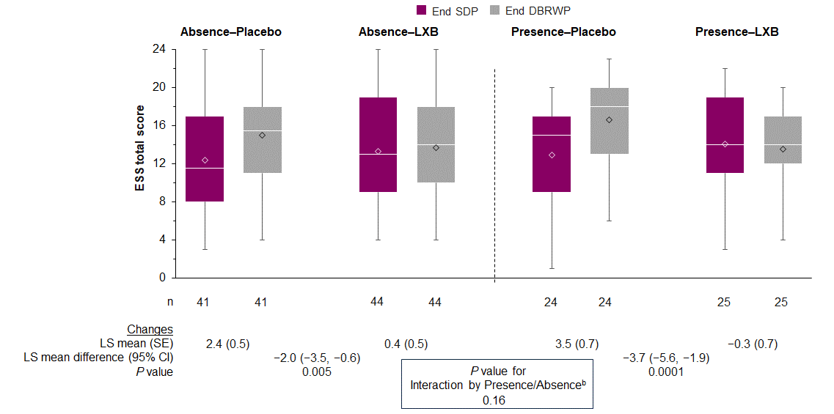
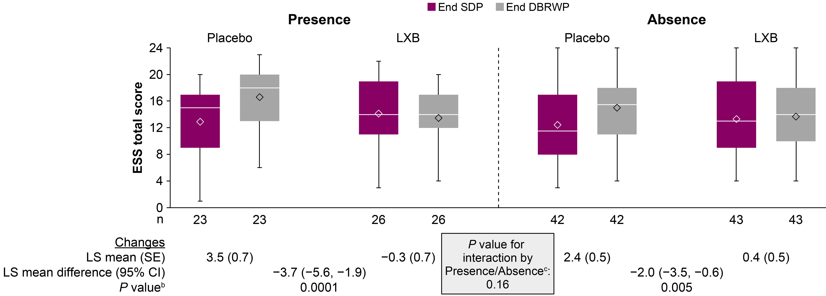
ESS Total Score by Presence/Absence of Psychiatric and/or Neurologic Comorbiditiesª
ªEfficacy population; includes all randomized participants who took ≥1 dose of double-blind study drug and have ≥1 set of post-randomization efficacy assessment. ^{b}P values are not adjusted for multiple comparisons. ^{c} The interaction compares the LXB effect (LS mean difference) in the presence group with that in the absence group. The bottom and top edges of the box indicate the first and third quartiles, the line inside the box is the median, and the diamond marker inside the box is the mean. The whiskers extending from the box indicate the minimum and maximum.
CI, confidence interval; DBRWP, double-blind randomized withdrawal period; ESS, Epworth Sleepiness Scale; LS, least squares; LXB, low-sodium oxybate; SDP, stable-dose period; SE, standard error.
Notes:
Speaker notes:
Participants in both subgroups showed a similar response. Those who were randomized to placebo showed worsening (increase) in their ESS scores, while those who stayed on LXB showed stable ESS scores.
ANNOTATIONS:
^Figure: T-14.1.5.1.3 Efficacy, p1CD (Presence), p1AB (Absence)
^LS means data: p1EF, p2AB
^Interaction term p-value: p2CF
^Sample sizes (n’s): T-14.1.5.1.3 Efficacy p1HIJK
^Footnote “a”: T-14.1.5.1.3 Efficacy, p1E
^Footnote “b”: p2D + note from verbal communication with Doug

Slide 10
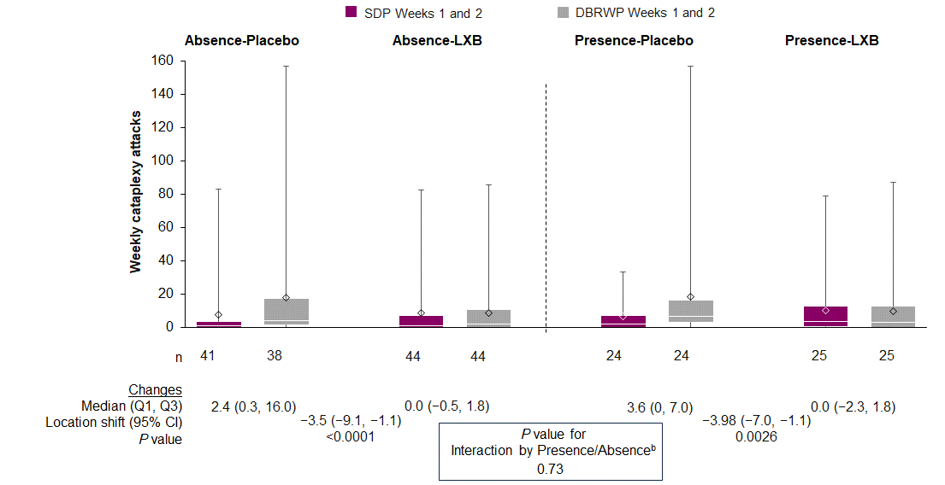
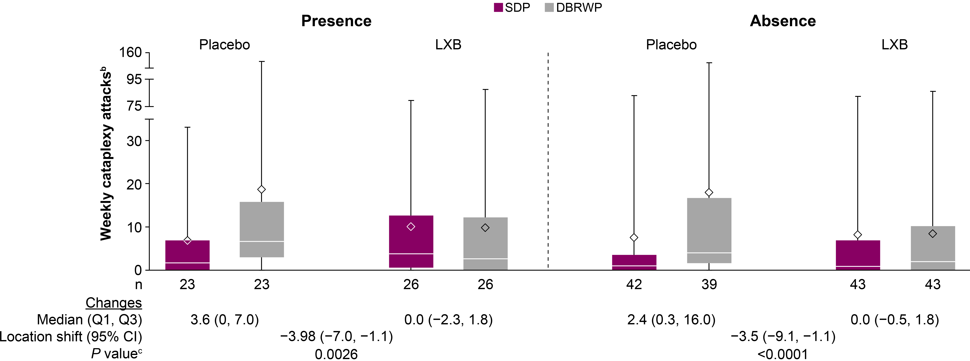
Cataplexy Attacks by Presence/Absence of Psychiatric and/or Neurologic Comorbiditiesª
ªEfficacy population; includes all randomized participants who took ≥1 dose of double-blind study drug and have ≥1 set of post-randomization efficacy assessment. ^{b}Cataplexy attacks that occurred during the 2 weeks of the SDP and during the 2 weeks of the DBRWP were analyzed. ^{c}P values are not adjusted for multiple comparisons. The bottom and top edges of the box indicate the first and third quartiles, the line inside the box is the median, and the diamond marker inside the box is the mean. The whiskers extending from the box indicate the minimum and maximum.
CI, confidence interval; DBRWP, double-blind randomized withdrawal period; LXB, low-sodium oxybate; Q, quartile; SDP, stable-dose period.
Notes:
Speaker notes:
Participants in both subgroups who were randomized to placebo showed an increase in median weekly cataplexy attacks, while those who stayed on LXB showed stable median weekly cataplexy attacks.
ANNOTATIONS:
^Figure: T-14.1.5.1.3 Efficacy, p3B, p4B (Presence); p3A, p4A (Absence)
^Median change/location shift: p4CD, p5AB
^Sample sizes (n’s): T-14.1.5.1.3 Efficacy p3D-p4E, p3E-p4F, p3F-p4G, p3G-p4H

Slide 11
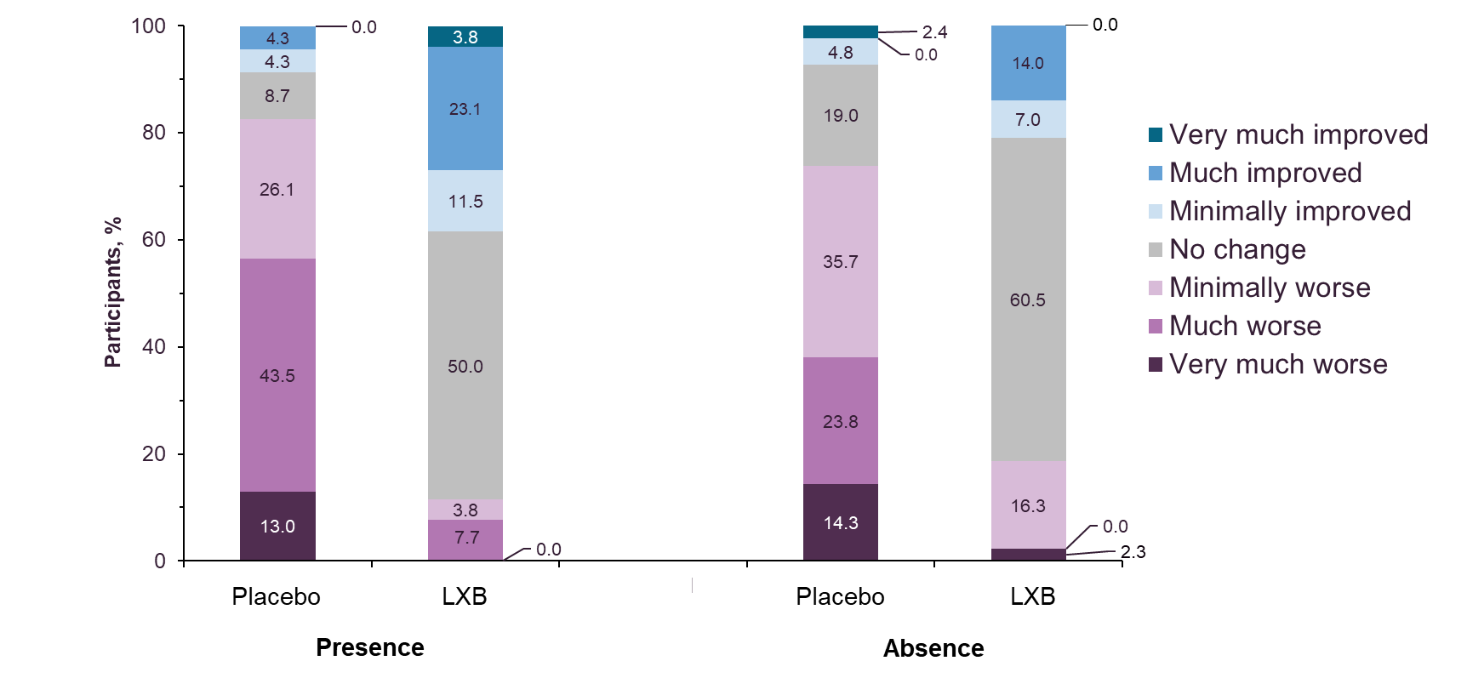
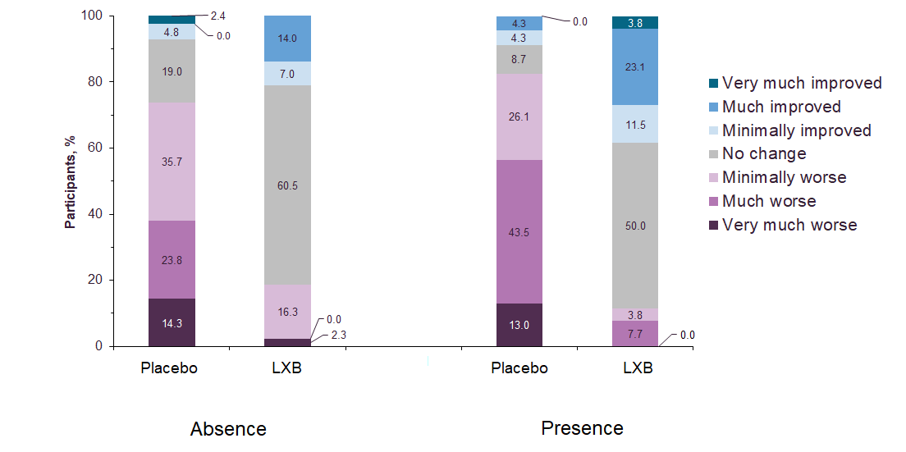
PGIc by Presence/Absence of Psychiatric and/or Neurologic Comorbiditiesª
ªEfficacy population; includes all randomized participants who took ≥1 dose of double-blind study drug and have ≥1 set of post-randomization efficacy assessment.
LXB, low-sodium oxybate; PGIc, Patient Global Impression of Change.
Notes:
Speaker notes:
Participants in the placebo groups generally reported worsening while participants in the LXB groups generally reported no change or improvement.
ANNOTATIONS:
^Figure: T-14.1.5.1.3 Efficacy, p6A-F

Slide 12
PHQ-9 Scores by Presence/Absence of Psychiatric and/or Neurologic Comorbidities^{a,b}
MCID for worsening
Baseline^{b}
MCID for improvement
Baseline^{c}
Week 2
Week 4
Week 6
Week 8
Week 12 End of OLOTTP
End of SDP
End of DBRWP^{d}
ªPHQ-9 measures the severity of depressive symptoms. ^{b}Safety population; includes all participants who took ≥1 dose of study drug. ^{c}Mean scores at baseline were 7.2 for participants with psychiatric and/or neurologic comorbidities and 6.6 for participants without psychiatric and/or neurologic comorbidities. ^{d}Excludes placebo. P≥0.05 for comparison of groups at all time points; P values are not adjusted for multiple comparisons. DBRWP, double-blind randomized withdrawal period; LS, least squares; MCID, minimum clinically important difference; OLOTTP, open-label optimized treatment and titration period; PHQ-9, Patient Health Questionnaire–9; SDP, stable-dose period; SE, standard error.
Notes:
Speaker notes:
Changes in PHQ–9 scores from baseline to various time points throughout the study did not significantly differ between subgroups.
There were no increases in severity of depressive symptoms from baseline in either subgroup.
ANNOTATIONS:
^Figure: T-14.1.5.1.3 Efficacy, p7AB, p8AC, p9B, p10AC, p11AC
^MCID values: Kroenke 2012, p1A
^Footnote “a”: T-14.1.5.1.3 Efficacy, p7A, p12A
^Footnote “b”: T-14.1.5.1.3 Efficacy, p7F
^Footnote “c” T-14.1.5.1.3 Efficacy, p12B, p7A
Speaker notes:
^T-14.1.5.1.3 Efficacy, p7C, 8C, 9C, 10B, 11CD
^15-006 Final Clinical Study Report, p46A; ^Kroenke 2012, p281A (PHQ9 measures severity of depressive symptoms)
^Figure: T-14.1.5.1.3 Efficacy, p7AB, p8AB, p9B, p10AC, p11AC (all negative numbers, thus no increases in PHQ9 score)

Slide 13
C-SSRS
Two participants had C-SSRS positive responses
One participant in the psychiatric and/or neurologic comorbidities subgroup (with a past history of depression) reported a TEAE of depression at week 9 (without concomitant suicidal ideation). This participant reported suicidal ideation on the C-SSRS at week 12 and again during the safety follow-up visit
One participant in the psychiatric and/or neurologic comorbidities subgroup reported pre-existing, but not active, suicidal ideation at study day 1. This participant reported suicidal ideation at week 4 and again at safety follow-up
No attempted or completed suicides occurred during the trial
C-SSRS data were analyzed from the safety population.
C-SSRS, Columbia-Suicide Severity Rating Scale; TEAE, treatment-emergent adverse event.
Notes:
ANNOTATIONS:
Bullet 1 (and sub-bullets): ^15-006 Final Clinical Study Report, p116B; 15-006 Final Clinical Study Report, p116B (study day 58; 58/7= 8.3 weeks); day 82; 82/7= 11.7
Bullet 2: ^T-14.1.5.1.3 Efficacy, p13ABC; ^15-006 Final Clinical Study Report, p116A
Bullet 3: ^15-006 Final Clinical Study Report, p116D, note that attempted or completed suicides would be reported as AE of suicidal ideation or behavior
Footnote: ^T-14.1.5.1.3 Efficacy, p13A

Slide 14
Summary of TEAEs by Presence/Absence of Psychiatric and/or Neurologic Comorbiditiesª
Characteristic | Presence of Psychiatric/Neurologic Comorbidities (n=84) | Absence of Psychiatric/Neurologic Comorbidities (n=117) | Total (N=201)
With ≥1 TEAE | 69 (82.1) | 84 (71.8) | 153 (76.1)
With ≥1 psychiatric and/or neurologic TEAE | 55 (65.5) | 63 (53.8) | 118 (58.7)
With ≥1 TEAE related to treatment | 36 (42.9) | 49 (41.9) | 85 (42.3)
With ≥1 serious TEAE | 1 (1.2) | 3 (2.6) | 4 (2.0)
With ≥1 serious psychiatric and/or neurologic TEAE | 0 | 1 (0.9) | 1 (0.5)
Confusional state | 0 | 1 (0.9) | 1 (0.5)
Hallucination, visual | 0 | 1 (0.9) | 1 (0.5)
Peripheral nerve paresis | 0 | 1 (0.9) | 1 (0.5)
ªSafety population; includes all participants who took ≥1 dose of study drug. ^{b}Note that participants could have reported ≥1 TEAE within a system organ class or preferred term.
TEAE, treatment-emergent adverse event.
Notes:
Speaker notes:
The percentages of treatment-related TEAEs were numerically similar across subgroups with and without psychiatric and/or neurologic comorbidities.
The percentages of participants reporting TEAEs in each subgroup were generally consistent with those of the total population, including the percentage of TEAEs deemed to be related to treatment.
ANNOTATIONS:
^t-14-03-01-02-01-0oxb129 TEAEs, p1ABC
^t-14-03-01-05-03-0oxb143, p1A
^t-14-03-01-05-03-0oxb143_2, p1A
^t-14-03-02-02-0oxb129 serious TEAEs, p1DE

Slide 15
Summary of TEAEs by Presence/Absence of Psychiatric and/or Neurologic Comorbiditiesª
Participants, n (%)^{b} | Presence of Psychiatric/Neurologic Comorbidities (n=84) | Absence of Psychiatric/Neurologic Comorbidities (n=117) | Total (N=201)
With ≥1 TEAE leading to withdrawal | 12 (14.3) | 9 (7.7) | 21 (10.4)
With ≥1 psychiatric and/or neurologic TEAE leading to withdrawal | 10 (11.9) | 8 (6.8) | 18 (9.0)
Cataplexy | 3 (3.6) | 4 (3.4) | 7 (3.5)
Cognitive disorder | 1 (1.2) | 0 | 1 (0.5)
Headache | 1 (1.2) | 1 (0.9) | 2 (1.0)
Somnolence | 0 | 1 (0.9) | 1 (0.5)
Abnormal sleep-related event | 0 | 1 (0.9) | 1 (0.5)
Anxiety | 1 (1.2) | 1 (0.9) | 2 (1.0)
Depressed mood | 2 (2.4) | 0 | 2 (1.0)
Depression | 2 (2.4) | 0 | 2 (1.0)
Irritability | 1 (1.2) | 1 (0.9) | 2 (1.0)
Sleep talking | 0 | 1 (0.9) | 1 (0.5)
Sleep-related eating disorder | 1 (1.2) | 0 | 1 (0.5)
ªSafety population; includes all participants who took ≥1 dose of study drug. ^{b}Note that participants could have reported ≥1 TEAE within a system organ class or preferred term.
TEAE, treatment-emergent adverse event.
Notes:
Speaker notes:
No trends were observed for discontinuation of LXB treatment due to any specific psychiatric or neurologic disorder.
ANNOTATIONS:
^t-14-03-02-03-01-0oxb129 TEAEs withdrawal, p1CE
^t-14-03-02-03-01-0oxb129 TEAEs withdrawal, p1AGF, p2B
^t-14-03-02-03-01-0oxb129 TEAEs withdrawal, p1G and F
Presence: (5 nervous system + 5 psychiatric = 10); 10/84 = 11.9%)
^t-14-03-02-03-01-0oxb129 TEAEs withdrawal, p1G and F
Absence: (6 nervous system + 2 psychiatric = 8); 8/117 = 6.8%)

Slide 16
Conclusions
In this analysis, the efficacy and safety of low-sodium oxybate were consistent regardless of presence or absence of psychiatric and/or neurologic comorbidities
This analysis is limited in that it is post hoc and involves a small number of participants; the underlying trial excluded certain, more severe psychiatric or neurologic comorbidities, which limits the generalizability of the findings
No trends were observed for discontinuation of LXB treatment due to any specific psychiatric or neurologic TEAEs
Notes:
ANNOTATIONS:
^Bullet 1: ESS (efficacy): LS means data: p1EF, p2AB, Interaction term p-value: p2CF; Cataplexy (efficacy): T-14.1.5.1.3 Efficacy, p3A, p4A (Absence); p3B, p4B (Presence); Median change/location shift: p4CD, p5AB; PHQ-9 (safety): T-14.1.5.1.3 Efficacy, p7C, 8C, 9C, 10B, 11CD
^Bullet 2: No major imbalances between groups on Slide 14 (TEAEs table)
^Bullet 3: Slide 8 (comorbidities list for inclusion is not exhaustive); subgroup n’s are 84 and 117 (Slide 9) compared with full phase 3 trial of 201 in safety population (Bogan 2021, p4B)

